Slide 1



Notes:
Good (morning/afternoon), everyone!
Today, we're diving into an important topic that might become relevant for many of us in the future - Medicare for Caregivers. Whether you’re assisting parents, grandparents, or other relatives, understanding Medicare is crucial for providing the best care.
This presentation will explain the basics of Medicare, helping you navigate through its parts, eligibility, enrollment, and more. Let's get started on this journey to becoming more informed caregivers and advocates for our loved ones' health care needs.

Slide 2


Introduction to
Medicare
Importance of understanding Medicare for caregivers
Overview of Medicare
  What is Medicare?
  Who is it for?
Notes:
(Bullet 1) Medicare is a cornerstone of healthcare for older adults and certain younger people with disabilities in the United States. Understanding Medicare isn't just about knowing the ins and outs of a health insurance program; it's about preparing ourselves to support our loved ones with the knowledge and confidence to navigate their healthcare needs effectively.
(Bullet 2) As caregivers, or future caregivers, grasping the basics of Medicare—what it covers, who's eligible, and how it works—equips us to make informed decisions and advocate for the best care possible.

Slide 3

Medicare
Eligibility and Enrollment
Criteria for Medicare eligibility
Enrollment periods and deadlines
Tips for timely enrollment to avoid penalties
Notes:
Understanding who is eligible for Medicare and when to enroll is key to ensuring continuous health coverage for your loved ones.
Medicare eligibility typically starts at age 65, but younger individuals with certain disabilities or conditions may also qualify.
There are specific enrollment periods, including the Initial Enrollment Period that happens around the time your loved one turns 65, and the General and Open Enrollment Periods for changes or late enrollment.
To avoid late penalties and ensure coverage starts when needed, it's important to enroll during these designated times. Being aware of these deadlines is crucial for caregivers managing healthcare planning.

Slide 4
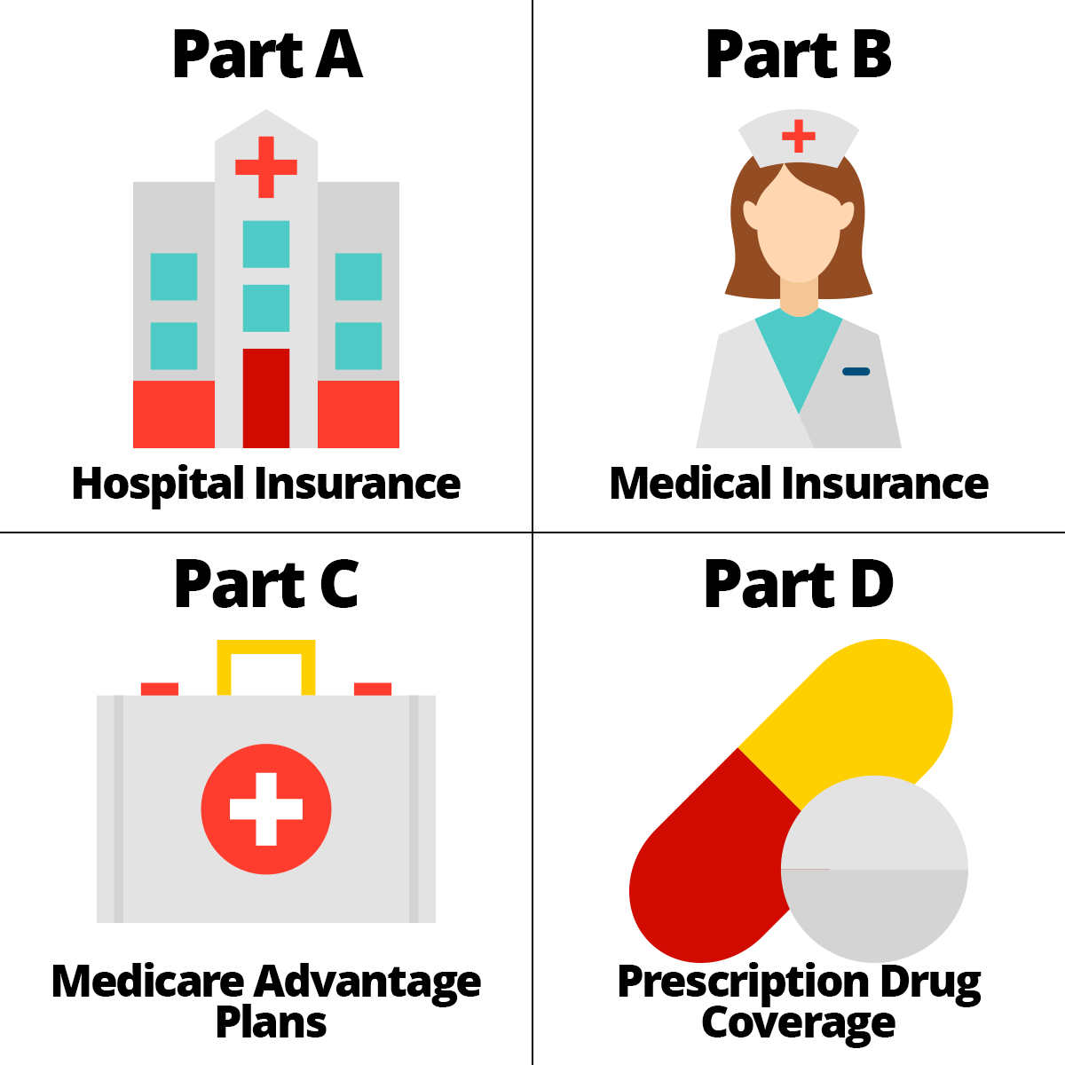
The Four Parts
of Medicare
Medicare Part A (Hospital)
  Inpatient hospital stays
  Skilled nursing facility care
  Hospice care
  Some home health care
Notes:
Next… it’s important to understand the structure of the Medicare program. Medicare is divided into four main parts, each designed to cover different healthcare needs and services. This structure provides a comprehensive approach to health insurance for eligible individuals, ensuring various aspects of healthcare are covered.
Medicare Part A, often referred to as hospital insurance, covers essential hospital services. This includes inpatient care in hospitals, skilled nursing facility care, hospice, and some home health care services. It's the first cornerstone of Medicare coverage, ensuring that significant, more intensive healthcare needs are met for those eligible.

Slide 5
The Four Parts
of Medicare
Medicare Part B (Medical)
  Certain doctors’ services
  Lab tests & x-rays
  Outpatient care
  Medical supplies
  Preventive services
Notes:
Next, we have Medicare Part B, which focuses on medical insurance.
This part covers outpatient care, labs & x-rays, essential medical services not provided in hospitals, durable medical equipment, and preventive services like screenings and vaccines. Part B plays a pivotal role in maintaining one’s health by covering regular doctor visits and necessary medical supplies.

Slide 6
The Four Parts
of Medicare
Medicare Part C (Advantage Plans)
  Offered by private companies approved by Medicare
  Includes Part A and Part B
  Most include Part D
  May offer extra coverage such as vision, hearing, dental and/or health and wellness programs
Notes:
Medicare Part C, or Medicare Advantage, offers an alternative way to receive your Medicare benefits.
Part C combines Parts A, B, and often D, through private insurance companies. It's an all-in-one alternative to Original Medicare, with the bonus of additional benefits like dental and vision care.

Slide 7
The Four Parts
of Medicare
Medicare Part D (Prescriptions)
  Adds prescription drug coverage to other plans including Original Medicare
Notes:
Lastly, Medicare Part D adds prescription drug coverage to Original Medicare, filling a vital gap in healthcare needs.
It's offered through Medicare-approved private insurers. For caregivers managing medication needs, knowing how Part D works can significantly reduce out-of-pocket costs and ensure loved ones have access to necessary medications.

Slide 8

Understanding Medicare:
Part A & Part B
Costs associated with Part A & Part B
Choosing between Original Medicare and Medicare Advantage
Notes:
Now that we’ve discussed the basic structure of Medicare, let's focus on Parts A and B, often referred to as Original Medicare. Remember we mentioned Part A covers hospital stays and skilled nursing care, while Part B covers outpatient care, doctor visits, and preventive services.
(Bullet 1) Both have associated costs, including premiums, deductibles, and copayments, which vary based on factors like work history and income.
(Bullet 2) When deciding between sticking with Original Medicare or opting for Medicare Advantage (Part C), consider the costs, coverage needs, and preference for flexibility in choosing healthcare providers.

Slide 9

Navigating Medicare Advantage (Part C)
Pros and cons of
Medicare Advantage
  Network restrictions
  Additional costs
  Enhanced benefits
How to compare and choose a plan
Notes:
(Bullet 1) For caregivers, selecting a Medicare Advantage plan requires a deeper understanding of the beneficiary’s needs and how different plans cater to those needs. Consider:
1. Network Restrictions: Medicare Advantage plans might restrict patients to network providers, impacting choice and accessibility of care.
2. Additional Costs: Out-of-pocket expenses can vary significantly, so it's essential to balance the trade-off between monthly premiums and the costs incurred when accessing care.
3. Enhanced Benefits: Beyond standard Medicare, these plans can offer wellness programs, dental, vision, and even fitness benefits, providing more holistic health coverage.
(Bullet 2) Use the Medicare Plan Finder tool to compare plan options, considering both healthcare needs and financial implications to find the best fit.

Slide 10

Prescription Drug Coverage (Part D)
Importance of Part D
How to enroll in Part D and managing the coverage gap
Tips for reducing prescription drug costs
Notes:
(Bullet 1) Medicare Part D plays a crucial role in ensuring Medicare beneficiaries have affordable access to prescription medications. This coverage helps manage healthcare costs by covering a portion of prescription drug expenses.
(Bullet 2) It's important to enroll in Medicare Part D during your initial eligibility period to avoid late enrollment penalties. While the coverage gap, often referred to as the 'donut hole,' may not always be avoidable, strategies such as choosing generic drugs, utilizing mail-order services, and applying for Extra Help can mitigate costs during this phase.
(Bullet 3) To help reduce prescription drug costs in general, consider the following tips:
Compare plans during open enrollment to find one that covers your medications at the lowest cost.
Use your plan’s preferred pharmacies or mail-order service for additional savings.
Ask your doctor about generic or less expensive brand-name drugs that could work for you.
Look into pharmaceutical assistance programs offered by drug manufacturers or state programs designed to aid with prescription costs.

Slide 11

Medicare Supplement Insurance
What is Medigap?
How does Medigap work with Original Medicare?
Things to consider when choosing a Medigap policy
Medigap
Notes:
(Bullet 1 & 2) Medigap, or Medicare Supplement Insurance, is designed to cover costs not covered by Original Medicare, such as deductibles, copayments, and coinsurance. When choosing a Medigap policy, people should consider factors like the different benefits offered by each plan type, the costs, and how premiums may increase over time.
(Bullet 3) It’s also important to enroll during the Medigap open enrollment period to guarantee coverage regardless of health status.

Slide 12
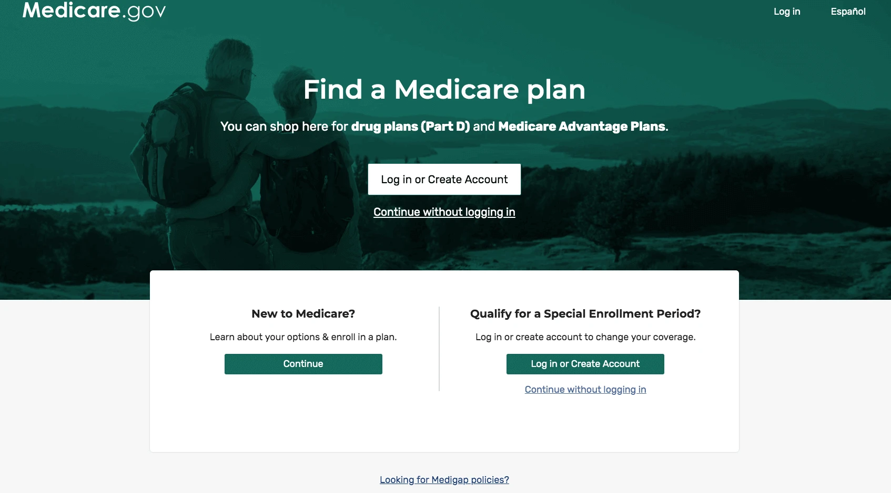

Tools & Resources for Caregivers
Medicare Plan Finder
State Health Insurance Assistance Program
Notes:
For caregivers navigating Medicare for a loved one, a wealth of online tools and resources are available to simplify the process.
We’ve mentioned the Medicare Plan Finder as a vital tool for comparing plans based on costs, coverage, and pharmacy preferences, helping you make informed decisions.
Additionally, the State Health Insurance Assistance Program (SHIP) offers personalized assistance for understanding Medicare options and benefits. Leveraging these resources can empower you with the knowledge and support needed to manage healthcare planning efficiently and effectively.

Slide 13

Preparing for
Caregiving Responsibilities
Legal and financial considerations
Communicating effectively with healthcare providers
Managing healthcare information securely and efficiently
Notes:
As you can see, there is a lot involved in caring for an aging loved one.
(Bullet 1) Stepping into a caregiving role involves crucial legal and financial planning, including establishing power of attorney and advanced directives to ensure decisions align with your loved one's wishes.
(Bullets 2&3) Effective communication with healthcare providers is key to navigating care options and treatments, while secure and efficient management of healthcare information helps in organizing appointments, medical records, and medication schedules. These steps not only prepare you for the responsibilities ahead but also ensure a smoother care journey for both you and your loved one.

Slide 14




Conclusion / Q&A
Recap: Empowering caregivers with knowledge and resources
Questions? / Discussion
Sponsored by:
Notes:
(Bullet 1) We've covered a lot about Medicare and the critical role caregivers play in managing healthcare for their loved ones. From understanding the different parts of Medicare to navigating enrollment and utilizing additional resources like Medigap and SHIP, we hope this presentation empowers you with the knowledge you need.
(Bullet 2) Now, we'd love to hear from you—any questions or points for discussion? Your insights and experiences are invaluable as we all learn more about supporting our loved ones through their healthcare journeys.
We’d also like to say Thank You to the sponsors of this lesson – Lifesmarts, a program of the National Consumer League, and AARP®. AARP® is a registered trademark.

Slide 15
THANK
YOU
Notes:
Thank You

