Slide 1
Notes:
Talking Points –
Welcome your audience to the presentation “10 Things I Wish My Parents Knew About Social Media”

Slide 2
2
Notes:
Talking Points –
Introduce the sponsors of this program – Lifesmarts, the National Consumers League, and META (parent company of Facebook and Instagram)

Slide 3
ABOUT OUR TEAM
FIRST NAME 1
FIRST NAME 2
FIRST NAME 3
FIRST NAME 4
GRADE -
LIFESMARTS FOCUS -
GRADE -
LIFESMARTS FOCUS -
GRADE -
LIFESMARTS FOCUS -
GRADE -
LIFESMARTS FOCUS -
3
Notes:
(Choose this template if you have 4 members presenting.
Delete the following page 5-member template)
Talking Points –
Introduce the members of your team, what school you are from, and what LifeSmarts area you will be focusing on in competition.

Slide 4
ABOUT OUR TEAM
FIRST NAME 1
FIRST NAME 2
FIRST NAME 3
FIRST NAME 4
FIRST NAME 5
GRADE -
LIFESMARTS FOCUS -
GRADE -
LIFESMARTS FOCUS -
GRADE -
LIFESMARTS FOCUS -
GRADE -
LIFESMARTS FOCUS -
GRADE -
LIFESMARTS FOCUS -
4
Notes:
(Choose this template if you have 5 members presenting.
Delete the previous page 4-member template)
Talking Points –
Introduce the members of your team, what school you are from, and what LifeSmarts area you will be focusing on in competition.

Slide 5
(Personalize this section. Talk about your team… what Lifesmarts is about… what you’ve learned… and what you’d like to achieve.)
(Second, explain the purpose of this presentation – to improve communication between parents and their children regarding social media)
5
Notes:
(Personalize this section. Add a fun photo of your team or a school mascot to the top of the page.
Talk about your team… what LifeSmarts is about… what you’ve learned… and what you’d like to achieve.)
(Second, explain the purpose of this presentation –
“The goal is to inspire future discussion about social media and how it is managed within your families”)
(The “Talking Points” sections will include additional background information that you can use to expand your knowledge and add to your presentations. It is not meant to be a script that is read verbatim, but rather research that will make you an “expert” on the topic before you are tasked with presenting it to others.
Hint: The links included lead to outside research, expert opinions, and statistics that may be used in future LifeSmarts competition questions.
Talking Points –
“In search of advice on how to parent teens whose social lives hinge on a click, I turned to Ana Homayoun, a Silicon Valley-based expert on teen behavior. Her book is Social Media Wellness: Helping Tweens and Teens Thrive in an Unbalanced Digital World. Homayoun acknowledges that even social-media-savvy parents may be missing the mark when it comes to guiding kids’ online interactions. “We’re having the wrong conversations with our kids around social media,” she says. “When we focus on fear and judgment — when we say ‘don’t do that because you’ll get in trouble,’ or ‘if you do that, you won’t get into college’ — kids will just go underground and find other ways to hide their online interactions.” Instead of scaring our kids or monitoring them 24/7, she says, we should focus on healthy socialization, effective self-regulation and safety. “We need to help kids make better choices intrinsically,” says Homayoun. “Give them freedom and responsibility, but with bumper lanes.”
The author recommends focusing on 3 things: Socialization, Self-regulation and Safety as parents and teens learn to maneuver through social media safely and responsibly. What do those three words mean to you? And how do you explain their importance to the adults in your life?

Slide 6
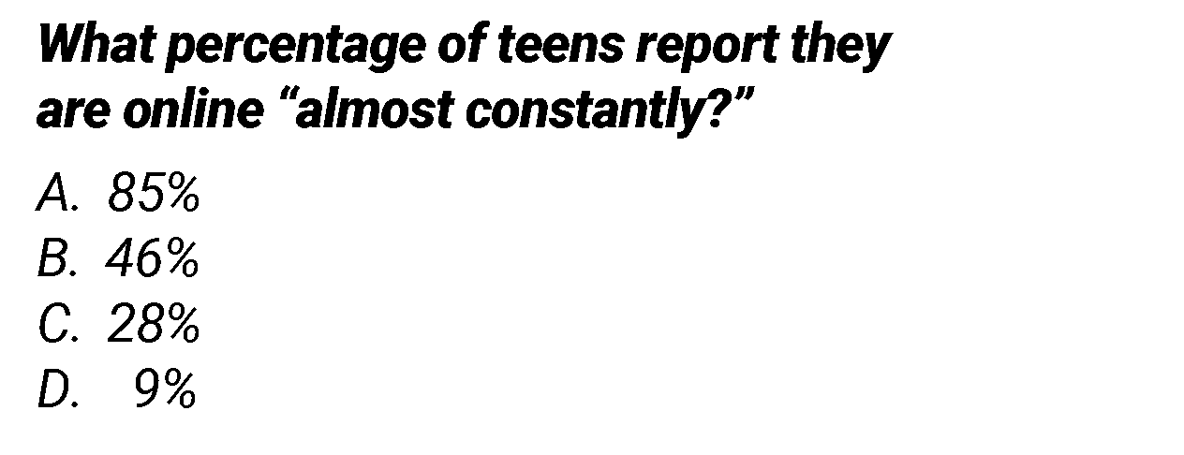
Internet Quiz
NEXT STEPS
6
Notes:
Talking Points -
Start with a quick “Internet Quiz.”
Let the parents know that the answers will be revealed within your presentation.
Question #1 - According to a Survey by the Pew Research Center- What percentage of teens report they are online “almost constantly?”
A. 85%
B. 46%
C. 28%
D. 9%
Source: https://www.pewresearch.org/internet/wp-content/uploads/sites/9/2022/08/PJ_2022.08.10_teens-and-tech_0-06b.png
Full article - https://www.pewresearch.org/internet/2022/08/10/teens-social-media-and-technology-2022/

Slide 7
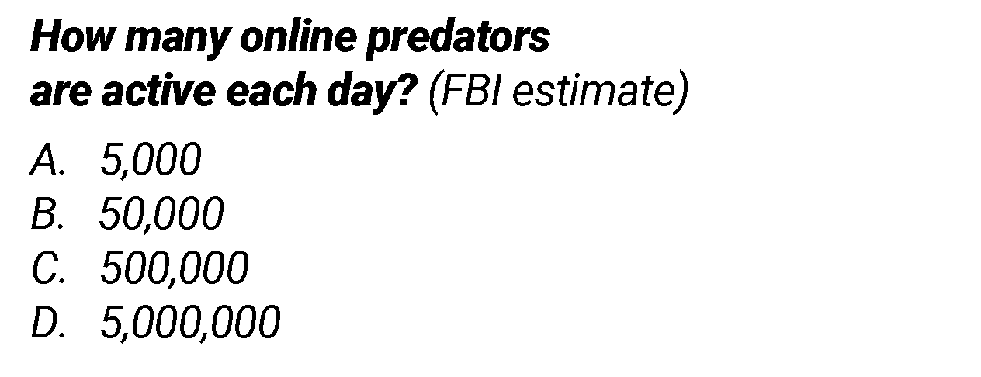
Internet Quiz
NEXT STEPS
7
Notes:
Talking Points -
Question #2 – How many online predators are active each day, according to FBI estimates?
A. 5,000
B. 50,000
C. 500,000
D. 5,000,000
Source: https://www.beaubidenfoundation.org/onlinepredatorsblog1/

Slide 8
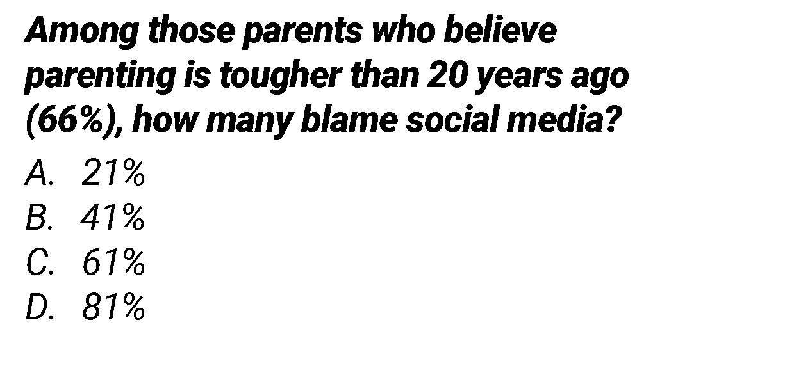
Internet Quiz
NEXT STEPS
8
Notes:
Talking Points -
Question #3 - Among those parents who believe parenting is tougher than it was 20 years ago (which is 66% of all parents)... how many blame social media and its negative impacts?
A. 21%
B. 41%
C. 61%
D. 81%
Source: https://www.pewresearch.org/internet/2020/07/28/parents-attitudes-and-experiences-related-to-digital-technology/pi_2020-07-28_kids-and-screens_04-01/
Full article: https://www.pewresearch.org/internet/2020/07/28/parents-attitudes-and-experiences-related-to-digital-technology/

Slide 9
Internet Quiz
NEXT STEPS
9
Notes:
Talking Points -
And now a bonus question for parents –
Can you name the apps that your child uses most frequently?
And double bonus points if you know how to use the apps yourself!
(Give parents a moment to think about it… maybe give them some hints if you can tell they are struggling. This will obviously vary by schools and regions of the country)
Notes to presenters -
(Congratulate them for their effort… and then introduce the main section of the presentation.
Here they will learn the answers to the questions that you have just asked, plus lots more information that should make them think.
The goal is to inspire future discussion about social media and how it is managed within their families)

Slide 10
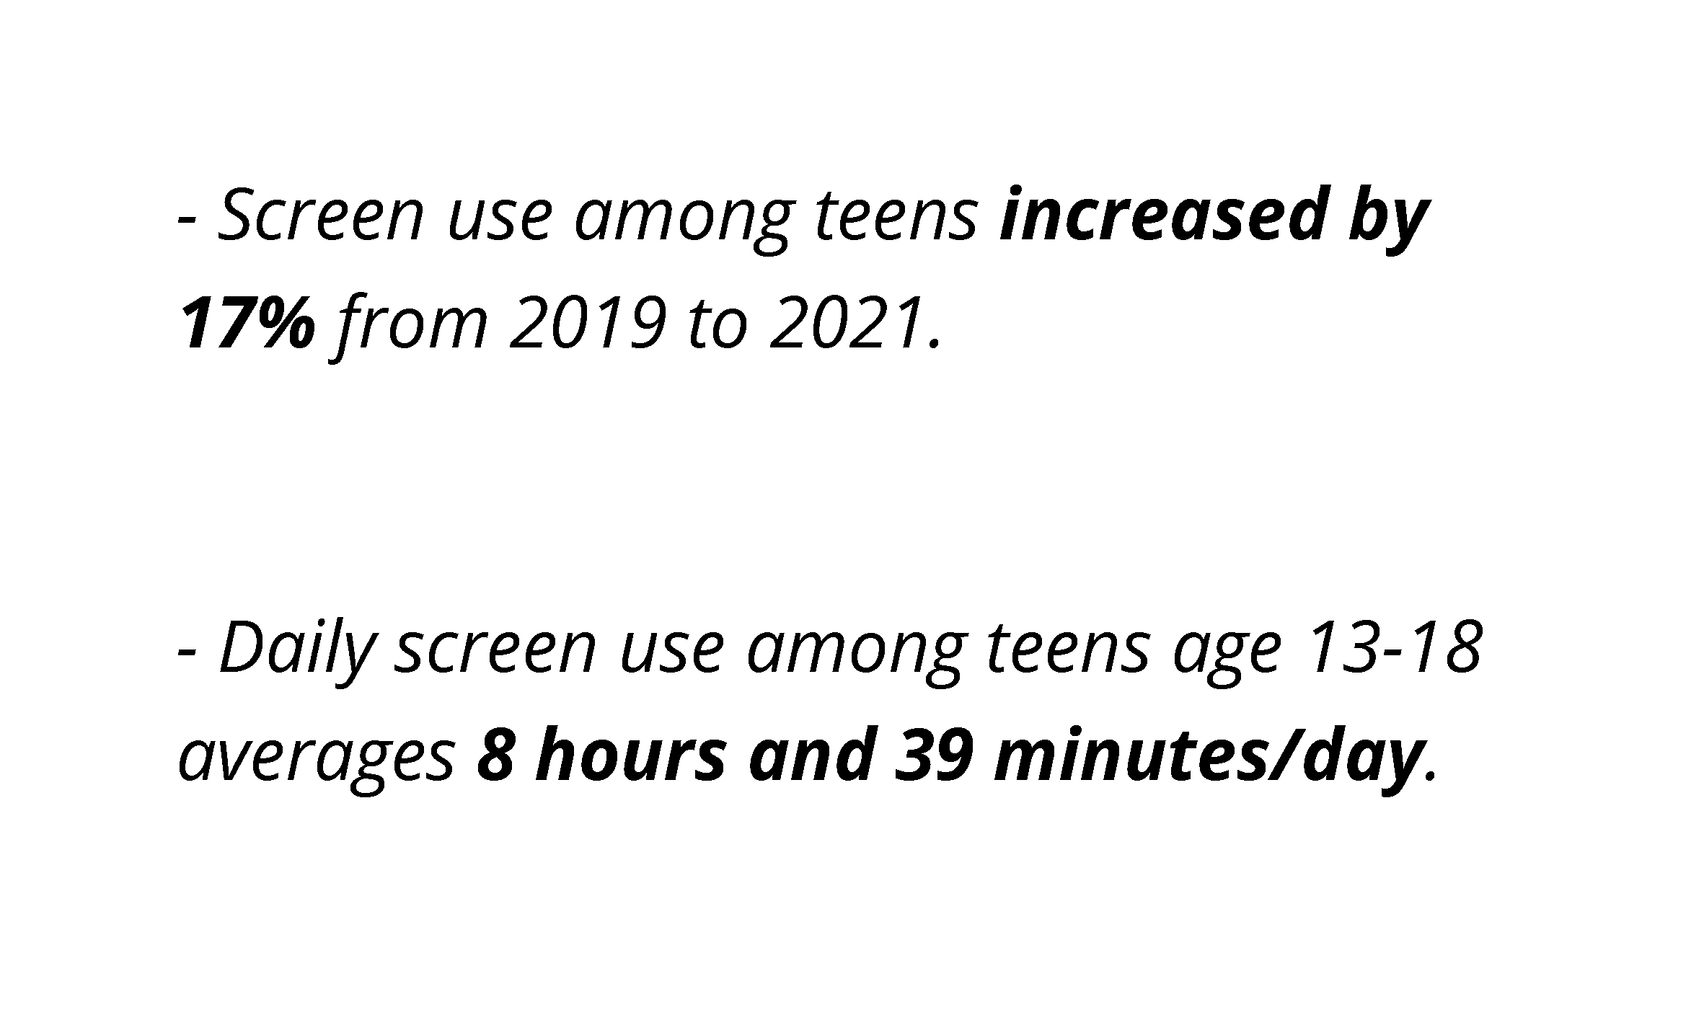
10
Notes:
The number one comment we hear from parents is –
“My teen spends too much time on their cell phone.”
And you probably have a point!
Screen use among teens increased by 17% from 2019 to 2021
Daily screen use among teens ages 13-18 averages 8 hours and 39 minutes per day
Talking Points –
This is based on a survey published by the nonprofit research group Common Sense Media.
This was during Covid, when many of us were quarantined, and attending school online, and screen use grew more rapidly than in the four years prior.
For 13-18 year olds, average screen time jumped by more than one hour per day!
Screen time for younger kids, ages 8-12, is also averaging 5 and a half hours per day.
Source - https://www.commonsensemedia.org/research/the-common-sense-census-media-use-by-tweens-and-teens-2021

Slide 11
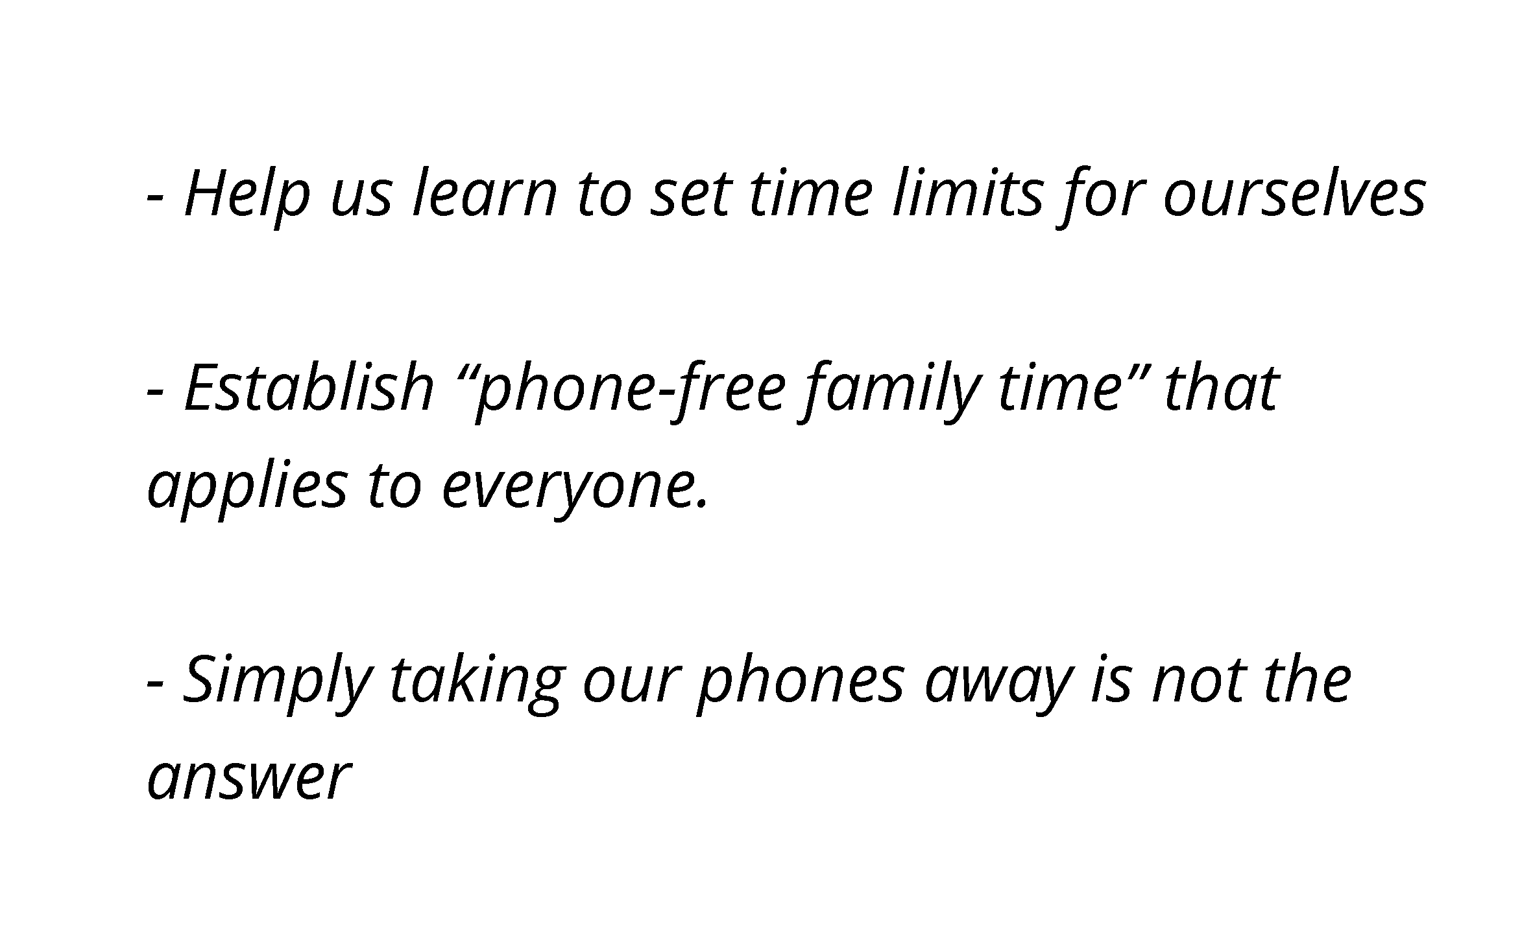
11
Notes:
Teens’ Response -
“Yep… sometimes we do spend too much time on out phones” and we don’t deny it.
Talking Points –
36% of teens think they spend too much time on social media according to a 2022 survey from the Pew Research Center. Only 8% of teens believe they don’t use social media enough.
Source: https://www.pewresearch.org/internet/2022/08/10/teens-social-media-and-technology-2022/pj_2022-08-10_teens-and-tech_0-12a/
Full article: https://www.pewresearch.org/internet/2022/08/10/teens-social-media-and-technology-2022/
In a small survey of Lifesmarts teens across the country, 58% of respondents believe they spend too much time on social media
Recommendations -
Help us learn to set time limits for ourselves
Encouraging teens to find effective ways to self-regulate is sometimes about getting their buy-in — that is, encouraging them to reflect on the impact their daily online habits are having on their personal, academic and extracurricular goals.
Talk to us about the “opportunity cost” of spending hours upon hours scrolling through digital media, and try to help us discover our “why.”
Have your teen ask themselves ‘Why am I picking up my phone? Am I bored, am I lonely, am I sad?’ It helps them make decisions that reflect their own values and choices and separate their online experiences from in-real-life ones,” according to Ana Homayoun, author of the book “Social Media Wellness.”
Asking themselves “why” also slows down impulsive online communications, and encourages kids to make smarter choices.
Establish “phone-free family time” that applies to everyone
Create opportunities for digital detox. “Give kids a budget to plan their own screen-free adventures — don’t just say, ‘Okay, kids, get offline and come do some chores,’” Ana Homayoun, author of the book “Social Media Wellness” says. She also points out that kidsvneed to learn how to be okay with being offline. Parents can start by modeling that behavior: No phones at the dinner table, for example, or no checking texts while you’re talking with your kid. And while most kids won’t admit it to their parents, an enforced break from technology could be just what they need.
Taking our phones away is not the answer
“The Honest Truth” - If you take away our phones, there are half a dozen other ways we can still access our social media accounts. Many of us also have hidden social media accounts that you don’t know about… like a Finsta… or “Fake Instagram.”
Source: https://www.washingtonpost.com/news/parenting/wp/2017/07/11/5-ways-parents-can-help-kids-balance-social-media-with-the-real-world/

Slide 12
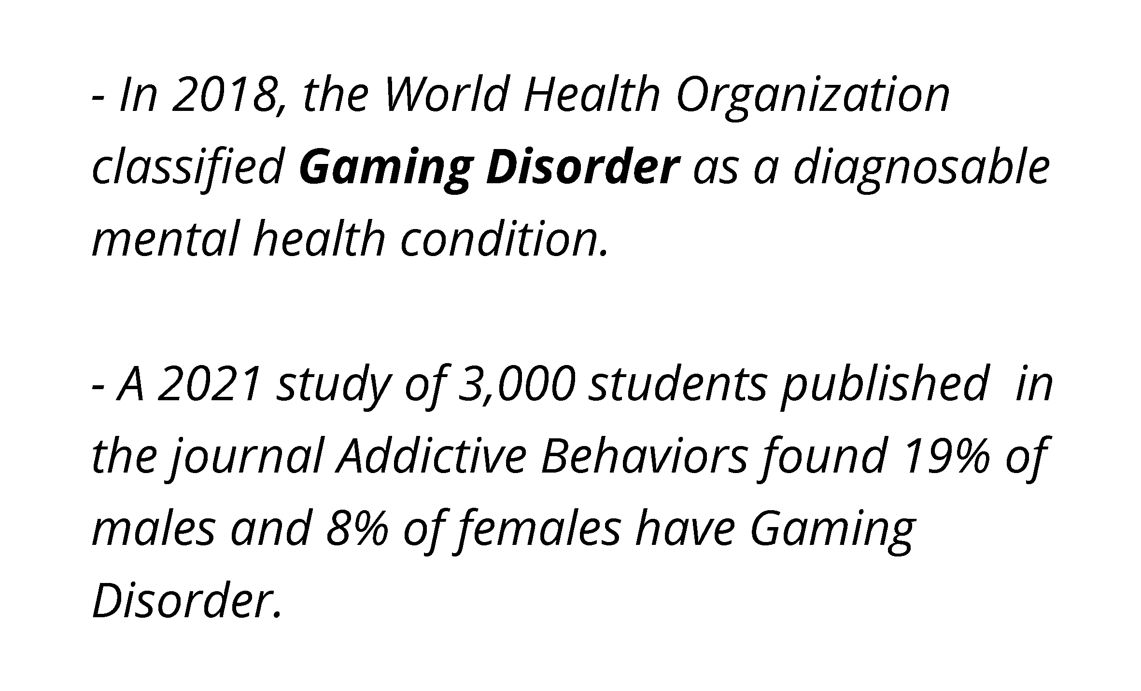
12
Notes:
And the number two complaint from parents feels like…
“All my child does is play games and watch videos online.”
In 2018, the World Health Organization classified Gaming Disorder as a diagnosable mental health condition
A 2021, study of 3,000 students published in the journal “Addictive Behaviors” found 19% of males and 8% of females were classified as having Gaming Disorder
Talking Points –
In 2018, the World Health Organization (WHO) recognized the severity of teenage video game addiction by classifying gaming disorder as a diagnosable mental health condition. Consequently, this disorder is included in the 11th edition of WHO’s International Classification of Diseases Manual. The WHO lists three main criteria for the diagnosis of gaming disorder:
An inability to control the urge to play video games
The feeling that gaming is more important than any other activity
Continuing to play video games despite the negative consequences of the behavior on relationships, academic performance, and/or work.
According to video game addiction statistics, a growing number of teens are addicted to gaming. A 2021 study in the journal Addictive Behaviors found that among 3,000 students, more than 19 percent of males and 7.8 percent of females were classified as having gaming disorder. And those numbers are likely to increase as the industry gains even more ground.
Source: https://www.newportacademy.com/resources/treatment/teenage-video-game-addiction/

Slide 13
13
Notes:
Teens’ Response –
Yes… gaming is fun and videos are entertaining, but we also learn a lot.
Talking Points –
The Honest Truth - You’ve probably heard “Video games help me cope with life,” or “video games help me relax.” But the truth is we all have something we turn to in an effort to escape… binge watching reality TV, reading an escapist novel, or taking a nap. We’re not saying kids should be allowed to avoid dealing with real life, but video games do serve a purpose.
In our own survey of LifeSmarts students we heard again and again how much teens learn online. One student told us that the reason he started working out was because he saw people his age working out on YouTube. Others told us that it gives them a way to express themselves, and it widens their circle of friends beyond just their small community.
Recommendations –
The internet allows us to socialize with people around the world
It opens our eyes to new cultures, hobbies and information
A student in our survey said, “I see people from different cultures and backgrounds explaining their daily lives. For example on TikTok right now I’m seeing a woman in Africa explain how she runs a shelter and takes care of all of the children there.”
We can explore the world without having to travel
This was especially important during Covid. And now that teens have seen all that the internet has to offer online they are continuing to use those resources. It’s not just about the video games… we promise.

Slide 14
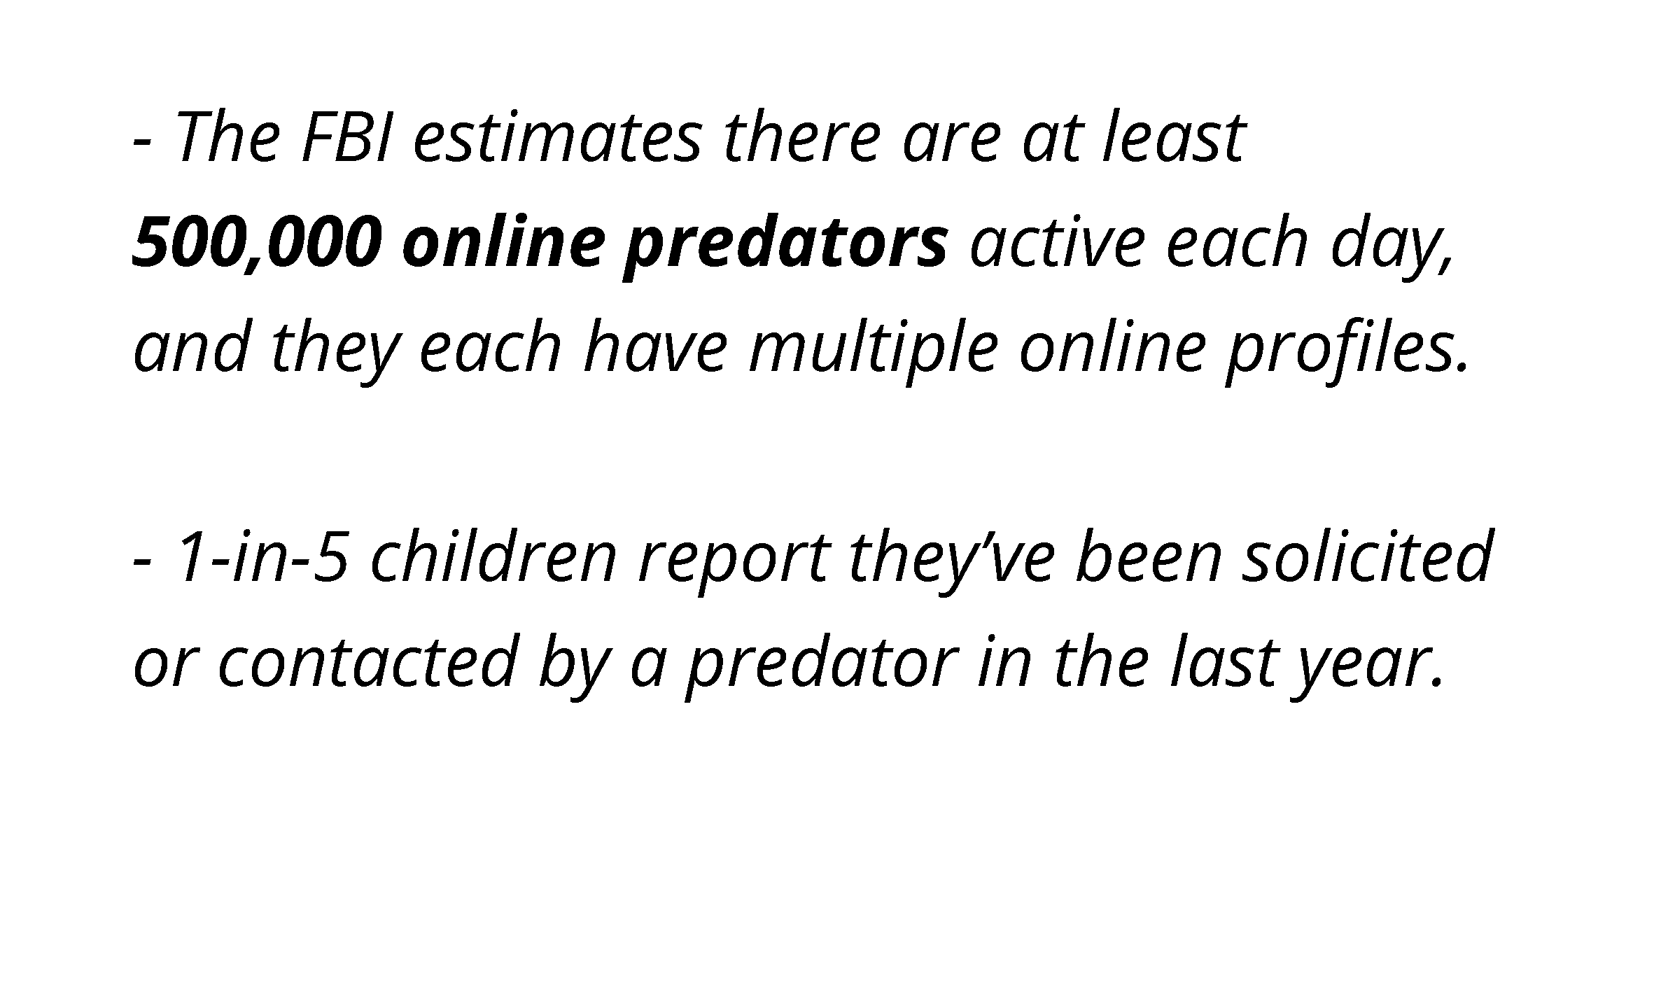
14
Notes:
We all know the importance of keeping ourselves safe in-person and online. Some parents say –
“Social media is dangerous; it’s full of hackers, predators and identity thieves”
The FBI estimates there are at least 500,000 online predators active each day, and they each have multiple profiles.
1-in-5 children report they’ve been solicited or contacted by a predator in the last year.
Talking Points –
The Internet and social media platforms provide access that didn’t exist before. Predators are able to lure and groom victims online. The FBI reports that every day there are at least 500,000 predators online. 1-in-5 children report they’ve been solicited or contacted by a predator in the last year.
Source: https://www.beaubidenfoundation.org/onlinepredatorsblog1/
Question for thought –
Have you ever asked your teen if they can identify any of the red flags of potential predators online?
Opening up this kind of discussion will tell you how aware your child is of potential online dangers.

Slide 15
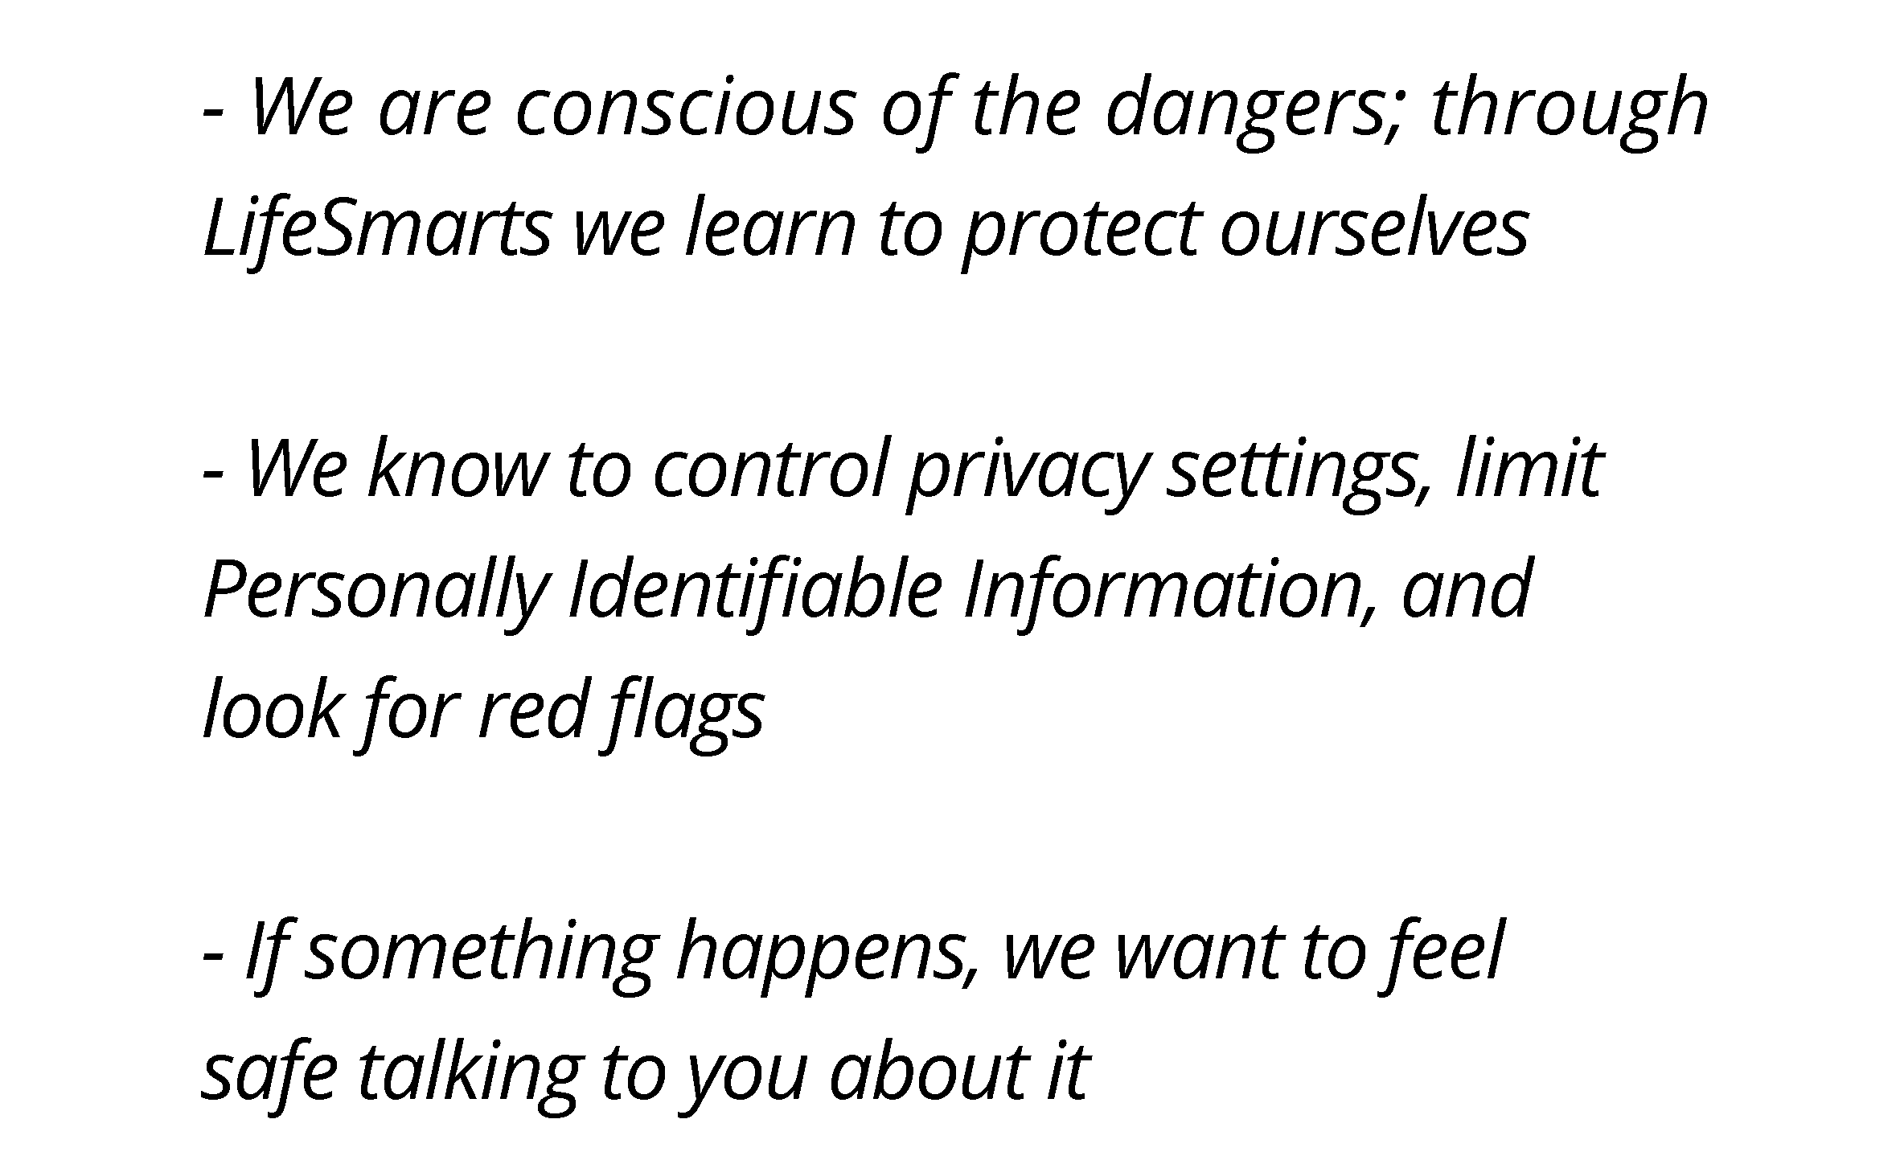
15
Notes:
Teens’ Response -
“There are dangers everywhere and social media is no exception.”
Talking Points –
39% of teens say things on social media are better than parents think
27% of teens say things on social media are worse than parents think
Source: https://www.pewresearch.org/internet/2022/11/16/connection-creativity-and-drama-teen-life-on-social-media-in-2022/pi_2022-11-16_teens-and-social-media_0-04/
Full article: https://www.pewresearch.org/internet/2022/11/16/connection-creativity-and-drama-teen-life-on-social-media-in-2022/
But we are aware of the dangers.
In our Lifesmarts survey, we were asked to rank our level of concern on a scale from 1-10
“Receiving obscene photos or messages” and “Predators claiming to be someone they’re not both received a score of 10 from ¼ of our respondents
Meanwhile, “Identity Theft” and “Invasion of Privacy” ranked highest overall
(Explain how Lifesmarts has taught you about P.I.I., Privacy Settings, and other online dangers to watch out for)
Recommendations –
We are conscious of the dangers and through Lifesmarts we learn to protect ourselves
(Talk about some of the things that you have learned through Lifesmarts that help you protect yourself online)
Control privacy settings; Limit Personally Identifiable Information; Look for Red Flags
“Help us keep an eye on who is following us.”
Even when kids keep social media accounts private or provide restricted access, anyone can request to follow or friend them
and potentially have full access to their postings. In a world where likes, loves, comments and follower counts have become
a barometer for popularity, teens might find it difficult to turn away potential followers, even when they should. Parents and
educators should encourage teens and tweens to curate access to their accounts.
Source: https://www.washingtonpost.com/news/parenting/wp/2018/01/09/what-teens-wish-their-parents-knew-about-social-media/
If something happens we want to feel safe talking to you about it
We want to know that you have our back and that we can come to you with any concern without you blowing things out of proportion. Trust that we know what we’re doing online, but if things get scary we can still come to you. As one of the students in our Lifesmarts survey put it. “Social media isn’t dangerous, children not knowing how to use it is dangerous. Parents shouldn’t fear the apps as long as they teach their children how to use them responsibly.”
The Honest Truth -
Supervise. Our children might hate our rules – we probably hate our rules too sometimes – but they want us to enforce the rules that keep them safe. At first glance, this might seem inconsistent with their need for autonomy, but it isn’t really. Our children want us to keep them safe, but they don’t want us intruding more than that. The struggle can be agreeing on what counts as ‘keeping them safe’ and what counts as ‘intruding’.
Source: https://www.heysigmund.com/technology-social-media-rules-children-teens-wish-parents-follow/

Slide 16
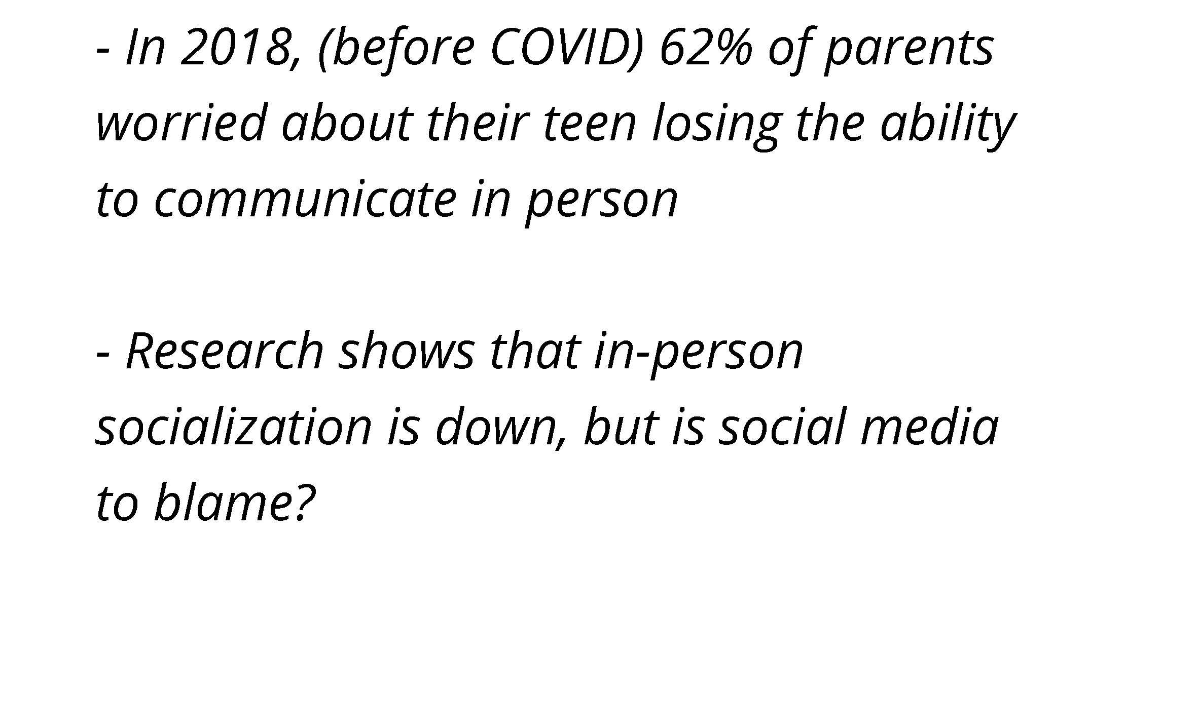
16
Notes:
While parents might think -
“Social media has affected my child’s ability to socialize normally”
it is not a case of “Invasion of the Bodysnatchers”
In 2018, (even before Covid) 62% of parents surveyed worried about their teen losing the ability to communicate in person
Research even shows that in-person socialization is down (which Covid may have reinforced) but is social media to blame?
Talking Points –
A 2018 survey by the Pew Research Center found that:
65% of parents worry about their teen spending too much time in front of their screens
62% worry about their teen losing the ability to communicate in person
61% worry about their teen sharing too much about their life online
59% worry about their teen being harassed or bullied online
57% worry about their teen sending or receiving explicit messages
Source: https://www.pewresearch.org/fact-tank/2019/03/22/how-parents-feel-about-and-manage-their-teens-online-behavior-and-screen-time/ft_19-03-22_parentsteenstech_65ofparents_2/
Full article: https://www.pewresearch.org/fact-tank/2019/03/22/how-parents-feel-about-and-manage-their-teens-online-behavior-and-screen-time/

Slide 17
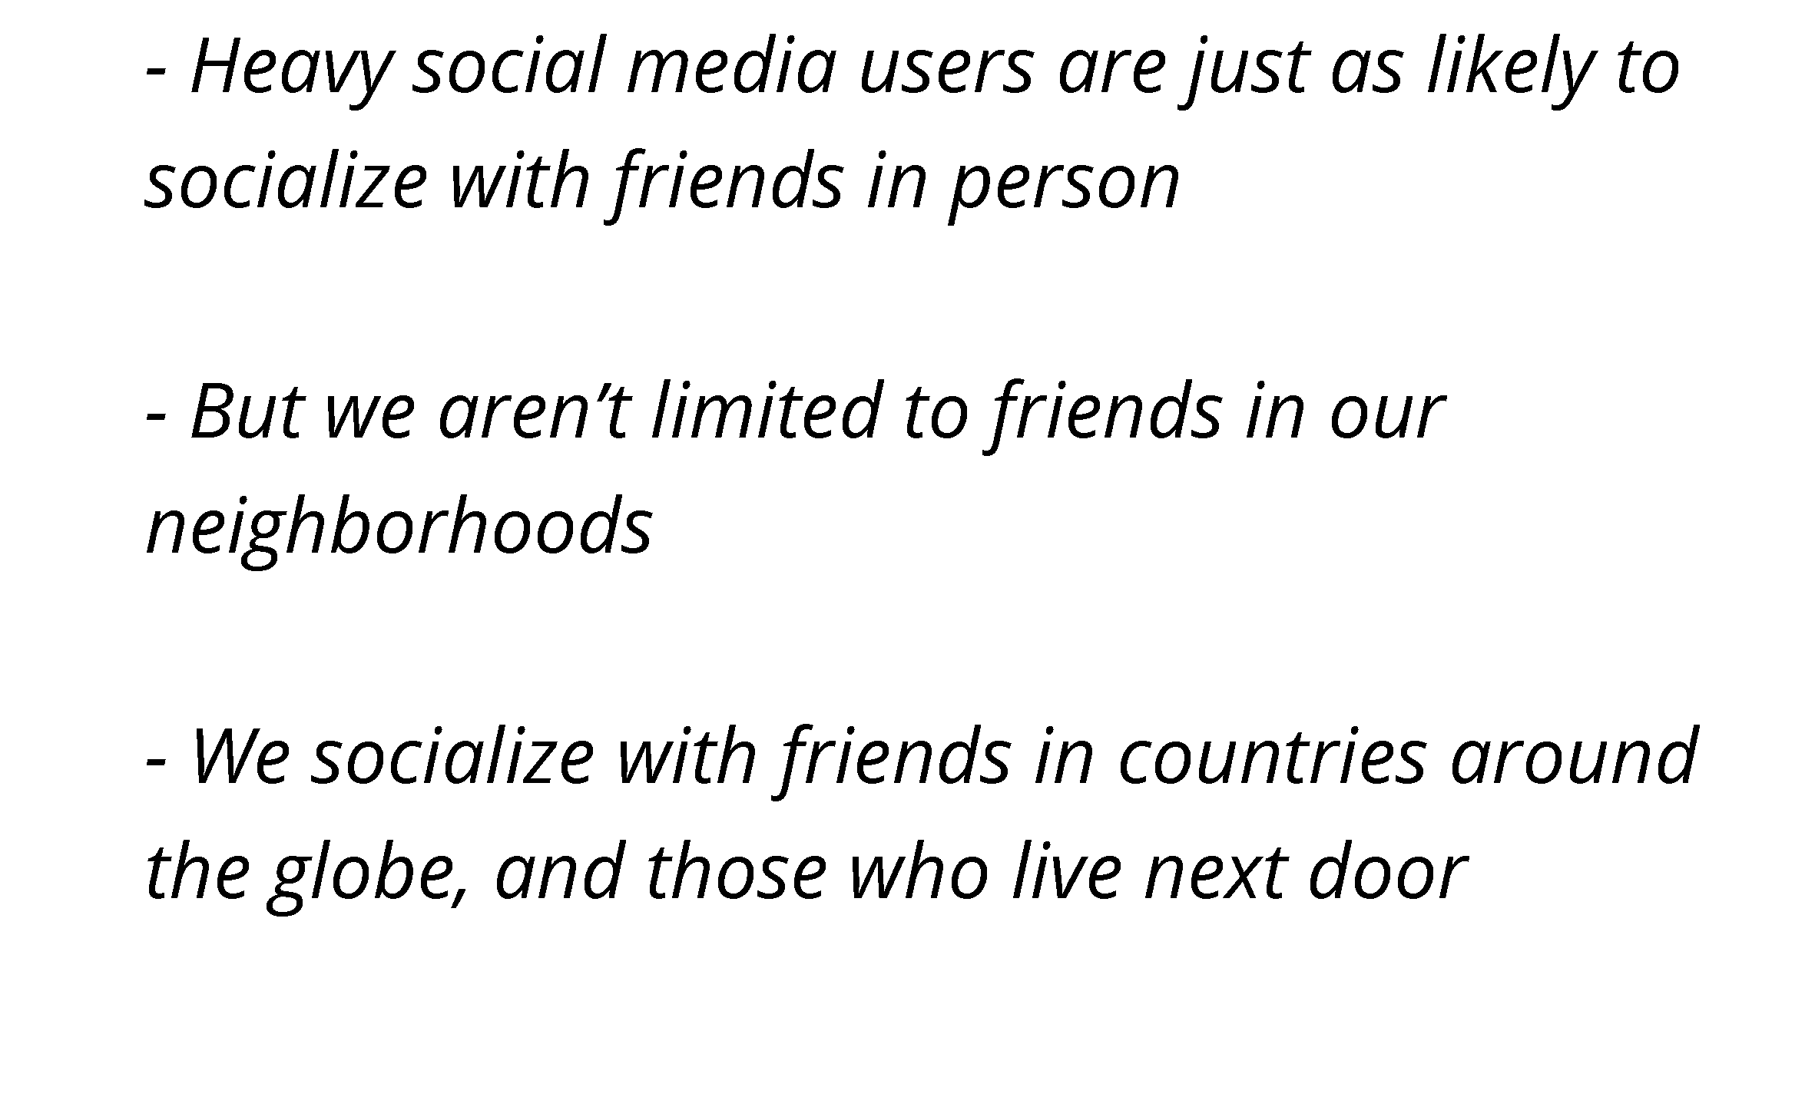
17
Notes:
Teens’ Response -
“Surprisingly, social media is not to blame!”
“Communicating online is ‘normal’ to us. But it doesn’t limit our in-person friends.”
Recommendations –
Heavy social media users are just as likely to socialize with friends in person
But we aren’t limited to friends in our neighborhoods
We socialize with friends in countries around the globe, and those who live next door
Talking Points –
The idea was that social media was replacing face-to-face interaction and it was referred to as “Social Displacement Hypothesis.” But research is showing that it looks to be false.
“We're seeing a transformation of where people are putting their attention,” Hall said. Noting that TikTok and YouTube are increasingly popular outlets for watching streaming content, Hall suggested social media time is likely borrowing from time spent watching TV, which, for decades, has been a major place where Americans spend their time. “Social media time is also borrowing from time at work or doing household chores,” Hall said.
Source: http://news.ku.edu/2022/05/05/person-socialization-down-social-media-isnt-to-blame
Use of the internet and social media is linked to STRONGER social ties, both among teens and adults.
Close to half of U.S. teens ages 13 to 17 say they are on the internet “almost constantly,” and more than nine-in-ten are social media users. These highly plugged-in youth, however, are just as likely as their less-connected peers to socialize regularly with their friends in person, according to a new analysis of Pew Research Center survey data.
In fact, when taking into account both online and offline interactions, highly connected teens report more contact with their friends compared with other teens, according to the analysis, which comes amid concerns that screen time is taking away opportunities for teens and others to socialize face-to-face.
Overall, 24% of teens who report being constantly online say they meet with their friends in person outside of school every day or almost every day. That is nearly identical to the 23% of less-frequently online teens who say they see their friends almost daily. And when it comes to online interaction with their friends, 69% of teens who are online constantly say they talk to their friends online every day or almost every day, compared with 52% of teens who visit the internet less frequently.
The survey also finds that teens who use five or more social media sites are significantly more likely than teens who use fewer sites to talk to their friends online every day or almost every day. Three-quarters of these social media users (75%) say this, compared with 41% of teens who use just one or two social media platforms. However, the frequency with which teens meet their friends in person does not significantly differ by the number of social media sites they use. Some 22% of teens who use one or two online platforms meet their friends in person on a near daily basis, compared with 26% of teens who use three or four social media sites and 23% of teens who use five or more sites.
Source: https://www.pewresearch.org/fact-tank/2018/11/28/teens-who-are-constantly-online-are-just-as-likely-to-socialize-with-their-friends-offline/

Slide 18
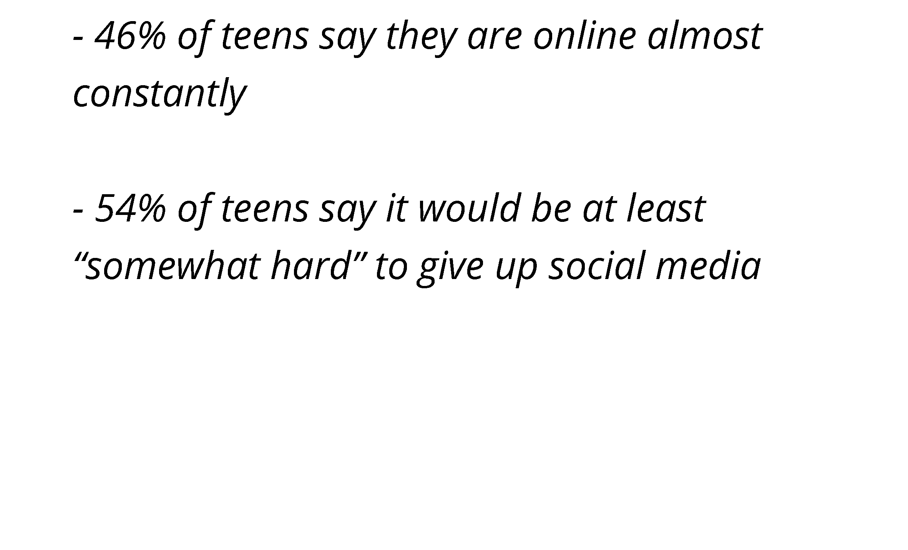
18
Notes:
Most parents have thought this at some point or another -
“My child is addicted to social media”
Talking Points –
46% of teens say they are online almost constantly.
97% of teens are daily internet users.
Source: https://www.pewresearch.org/internet/2022/08/10/teens-social-media-and-technology-2022/
54% of teens say it would be at least “somewhat hard” to give up social media
Asked about the idea of giving up social media, 54% of teens say it would be at least somewhat hard to give it up, while 46% say it would be at least somewhat easy. Teen girls are more likely than teen boys to express it would be difficult to give up social media (58% vs. 49%). Conversely, a quarter of teen boys say giving up social media would be very easy, while 15% of teen girls say the same. Older teens also say they would have difficulty giving up social media. About six-in-ten teens ages 15 to 17 (58%) say giving up social media would be at least somewhat difficult to do. A smaller share of 13- to 14-year-olds (48%) think this would be difficult.
Source: https://www.pewresearch.org/internet/2022/08/10/teens-social-media-and-technology-2022/

Slide 19
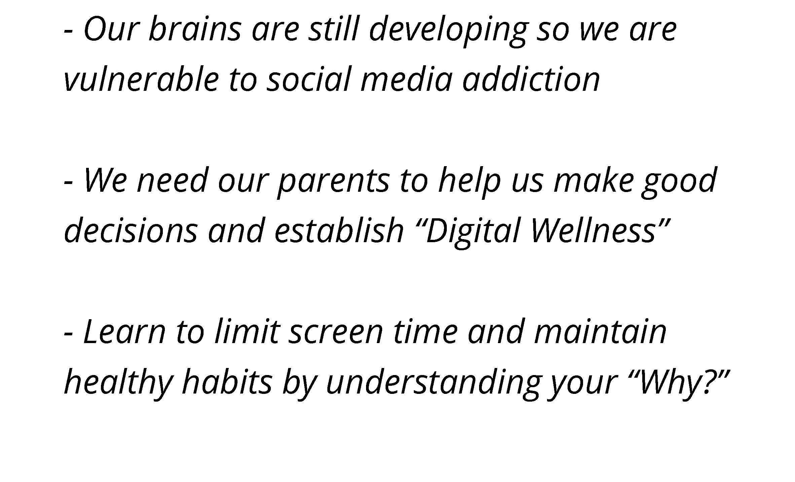
19
Notes:
Teens’ Response -
In fact, we asked students in our own survey if they could give up social media for a year and not a single person said they could do it. A couple people said they’d TRY for $10,000.
It’s hard to define social media addiction but…“Just like everyone else, sometimes we go “down the rabbit hole” and lose track of time.”
Talking Points –
Our brains are still developing so we are vulnerable to social media addiction
“The overuse of social media can actually rewire a young child or teen’s brain to constantly seek out immediate gratification, leading to obsessive, compulsive and addictive behaviors,” says DeAngelis. “This is what can make mental health disorders such as anxiety, depression, ADHD and body dysmorphia worse.”
Source: https://www.jeffersonhealth.org/your-health/living-well/the-addictiveness-of-social-media-how-teens-get-hooked
We need our parents to help us make good decisions and establish “Digital Wellness”
If you want teens to adopt better habits and healthier choices online and in-real life, adult need to change how they talk about the social world, both online and in-real-life. “In the end, promoting social media wellness is all about developing awareness and encouraging open communication, because teens who perceive their parents are unaware are less likely to seek their parents’ guidance and support in times of need — and that’s not a secret teens want to keep.”
Source: https://www.washingtonpost.com/news/parenting/wp/2018/01/09/what-teens-wish-their-parents-knew-about-social-media/
Learn to limit our screen time and maintain healthy habits (nutrition, exercise and sleep) by understanding your “Why?”
Parents should encourage kids to ask themselves ‘Why am I picking up my phone? Am I bored, am I lonely, am I sad? Am I just uncomfortable because I’m in a room where I don’t know anyone?’ Or ‘Why am I posting this? Does spending time on this app make me feel energized or drained?’ It helps us make decisions that reflect our own values and choices and separate our online experiences from in-real-life ones,” Ana Homayoun, author of the book “Social Media Wellness,” says. Asking ourselves “why” also slows down impulsive online communications, and encourages us to make smarter choices.

Slide 20
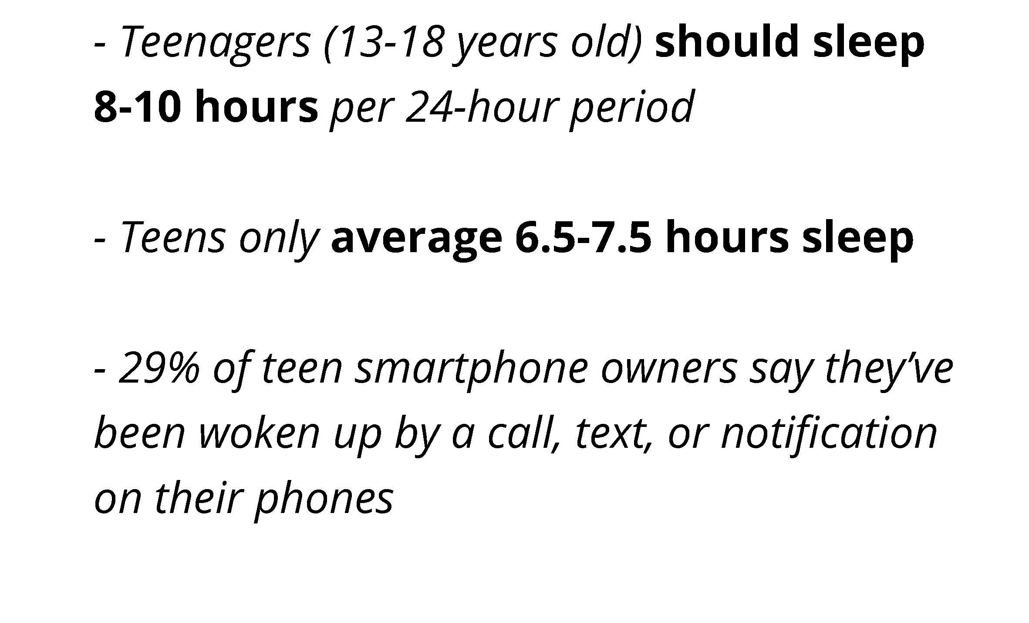
20
Notes:
Unless your child is a morning person, you know it’s tough getting them up… so you might be thinking –
“My child isn’t getting enough sleep because of social media”
Recommendations –
Teens should sleep 8-10 hours per 24-hour period
But most teens only average 6.5 to 7.5 hours sleep
29% of teen smartphone owners say they’ve been woken up by a call, text, or notification
Talking Points –
A 2018 study out of Australia found that the average teenager only got between 6.5 and 7.5 hours of sleep a night, well under the recommended 8-10 hours, and it was seriously impacting their mental wellbeing, with increased rates of depression, anxiety and low self-esteem among sleep-deprived teens. But the study also found a simple way for teens to reclaim some much needed shut-eye.
Teens who put down their smart-phones an hour before bed gained an extra 21 minutes sleep a night and an hour and 45 minutes over the school week.
The Sleep and Mental Wellbeing study also found:
Two-thirds of teenagers (66%) reported at least one symptom of a sleep disorder, such as insomnia
Sleep problems during childhood and adolescence are predictive of depression later in life
Up to 66% of young Australians experience symptoms of insomnia
Teenagers slept up to 90 minutes more on weekends due to being able to wake up later.
Source: https://www.vichealth.vic.gov.au/media-and-resources/media-releases/aussie-teens-forgo-sleep-for-screens
29% of teen smartphone owners say they’ve been woken up by their phones during the night by a call, text, or notification
Source: https://smartsocial.com/post/social-media-statistics

Slide 21
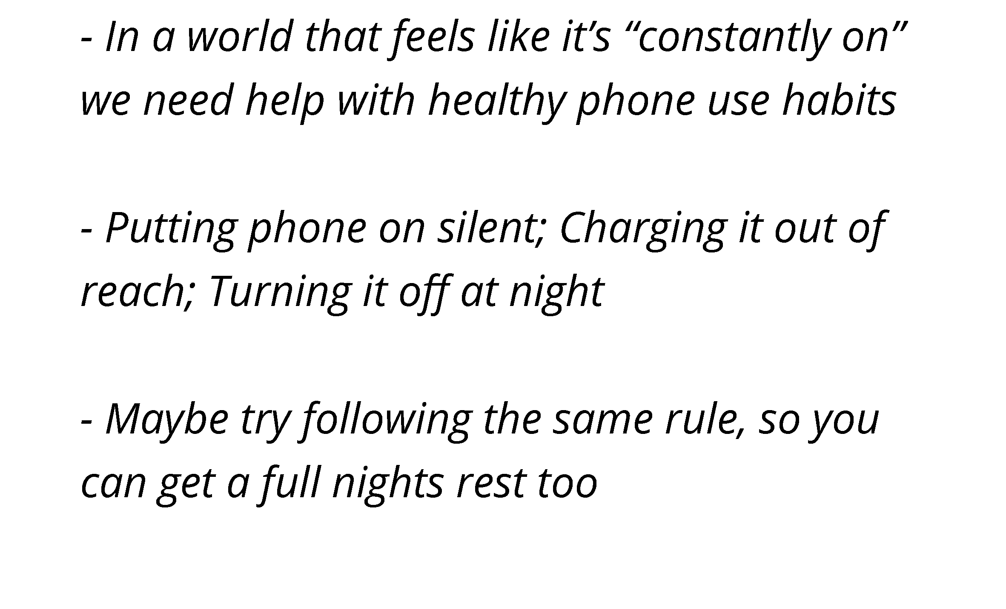
21
Notes:
Teens’ Response -
“FOMO (Fear of Mission Out) is real. Sometimes that keeps us up late at night, and wakes us at all hours.”
Recommendations:
“In a world that feels like it’s “constantly on” we need help with healthy phone use habits
Putting phone on silent; Charging it out of reach; Turning it off at night
Adopt a “bedtime” for your phone too. Put your phone on silent or turn it off at night to make sure you’re not among the 29% of teens whose sleep is interrupted by middle of the night alerts.
Maybe try following the same rule, so you can get a full night’s rest
Parents have just as difficult a time of “disconnecting” as teens do. Maybe make it a “family challenge” to see who can last longer without their phone. The best way to encourage healthy phone habits is to model it yourself.
Talking Points –
(Make sure to explain what FOMO is… many adults may not be familiar with the acronym)
As we’ve mentioned…
97% of teens are daily internet users. 46% say they are online almost constantly.
This is evidence that teens are worried that something important might happen if they are offline.
Source: https://www.pewresearch.org/internet/2022/08/10/teens-social-media-and-technology-2022/
Tip for Parents -
Encouraging kids to find effective ways to self-regulate is sometimes about getting their buy-in — that is, encouraging them to reflect on the impact their daily online habits are having on their personal, academic and extracurricular goals.
Source: https://www.washingtonpost.com/news/parenting/wp/2018/01/09/what-teens-wish-their-parents-knew-about-social-media/

Slide 22
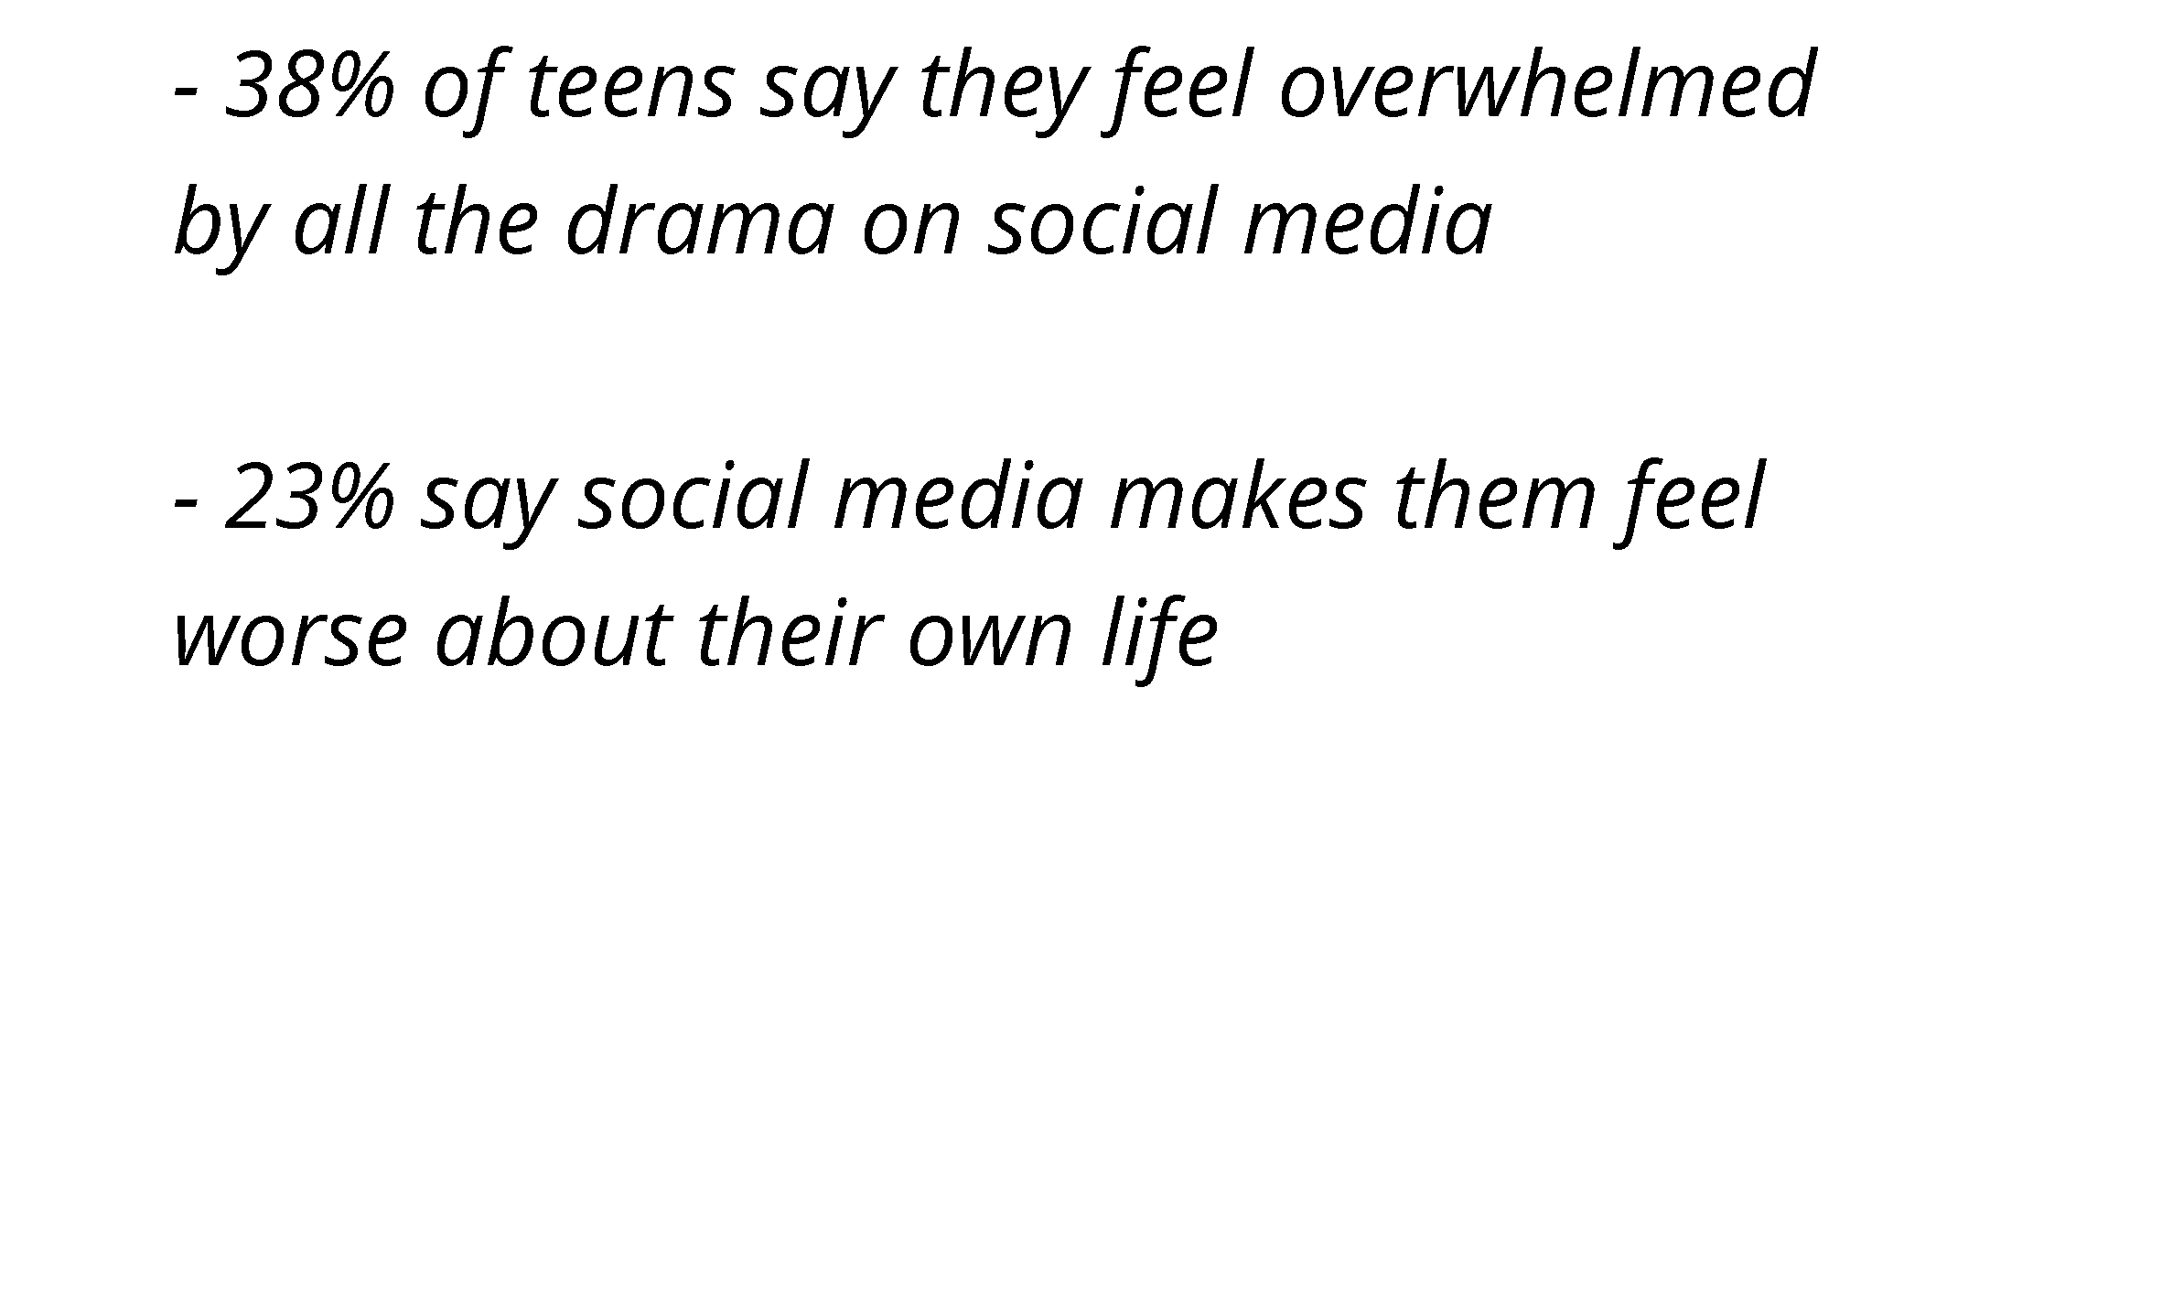
22
Notes:
This is something parents really worry about -
“Social media causes my child to have depression, anxiety & low self-esteem”
While social media has its positive points… there are negatives too.
Talking Points –
38% of teens say they feel overwhelmed by all the drama on social media
23% say social media makes them feel worse about their own life
The 2022 Pew Research Center survey found that overall:
38% of teens say they feel overwhelmed by all the drama on social media
31% of teens feel like their friends are leaving them out of things
29% feel pressure to post content that will get lots of comments or likes
23% say social media makes them feel worse about their own life
Source: https://www.pewresearch.org/internet/2022/11/16/connection-creativity-and-drama-teen-life-on-social-media-in-2022/pi_2022-11-16_teens-and-social-media_0-02a/
Full article: https://www.pewresearch.org/internet/2022/11/16/connection-creativity-and-drama-teen-life-on-social-media-in-2022/
“Teens who spend 3+ hours per day on social media may be at heightened risk for mental health problems, particularly internalizing problems.
A study published in the journal JAMA Psychiatry (Journal of the American Medical Association) suggests teens who spend 3+ hours per day on social media may be at heightened risk for mental health problems, particularly internalizing problems.
Future research should determine whether setting limits on daily social media use, increasing media literacy, and redesigning social media platforms are effective means of reducing the burden of mental health problems in this population.
Source: https://jamanetwork.com/journals/jamapsychiatry/article-abstract/2749480

Slide 23
23
Notes:
Teens’ Response -
“Some teens do need professional help, but for many, social media has a lot of positives.”
Talking Points –
Everyone is different. Please get professional help if you think your teen is struggling.
Parents should err on the side of caution if they think their teen is in trouble, and seek medical help
Keep the lines of communication open and talk to your teen if you see changes in mood, personality, or daily activity
There are many resources available including the “Crisis Text Line” which you can contact 24/7
Text HOME to 741741
Many teens believe the positives outweigh the negatives when digital use is managed in a healthy way
Teens report positive sentiments about social media including:
80% say that what they see on social media makes them feel more connected to what’s going on in their friends’ lives.
71% say it makes them feel like they have a place where they can show their creative side.
67% say these platforms make them feel as if they have people who can support them through tough times.
58% say it makes them feel more accepted.
Source: https://www.pewresearch.org/internet/2022/11/16/connection-creativity-and-drama-teen-life-on-social-media-in-2022/pi_2022-11-16_teens-and-social-media_0-01/
Full article: https://www.pewresearch.org/internet/2022/11/16/connection-creativity-and-drama-teen-life-on-social-media-in-2022/
In our small LifeSmarts survey, 54% of respondents say social media has had a positive impact on their mental health.

Slide 24
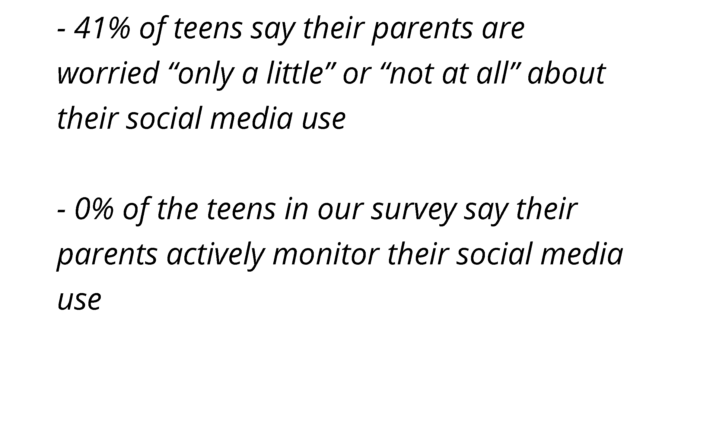
24
Notes:
Some parents ask –
“Should I be more closely monitoring my child on social media?”
Talking Points –
41% of teens in the Pew Research Survey say their parents are worried only a little or not at all about them using social media.
Source: https://www.pewresearch.org/internet/2022/11/16/connection-creativity-and-drama-teen-life-on-social-media-in-2022/pi_2022-11-16_teens-and-social-media_0-04/
Full article: https://www.pewresearch.org/internet/2022/11/16/connection-creativity-and-drama-teen-life-on-social-media-in-2022/
In fact, 0% of the students in our Lifesmarts survey say their parents actively monitor their social media use.
(Many students stated that because they are 18 years old or nearly 18, their parents trust that they know how to act responsibly online).
“Don’t bubble wrap your kids from tech! Show them how. Do it with them. Protect them from places they aren’t ready for and explain why. Right kid, right tech, right time. All the time.”
Source: https://protectyoungeyes.com/what-teens-wish-their-parents-understood-about-technology/

Slide 25
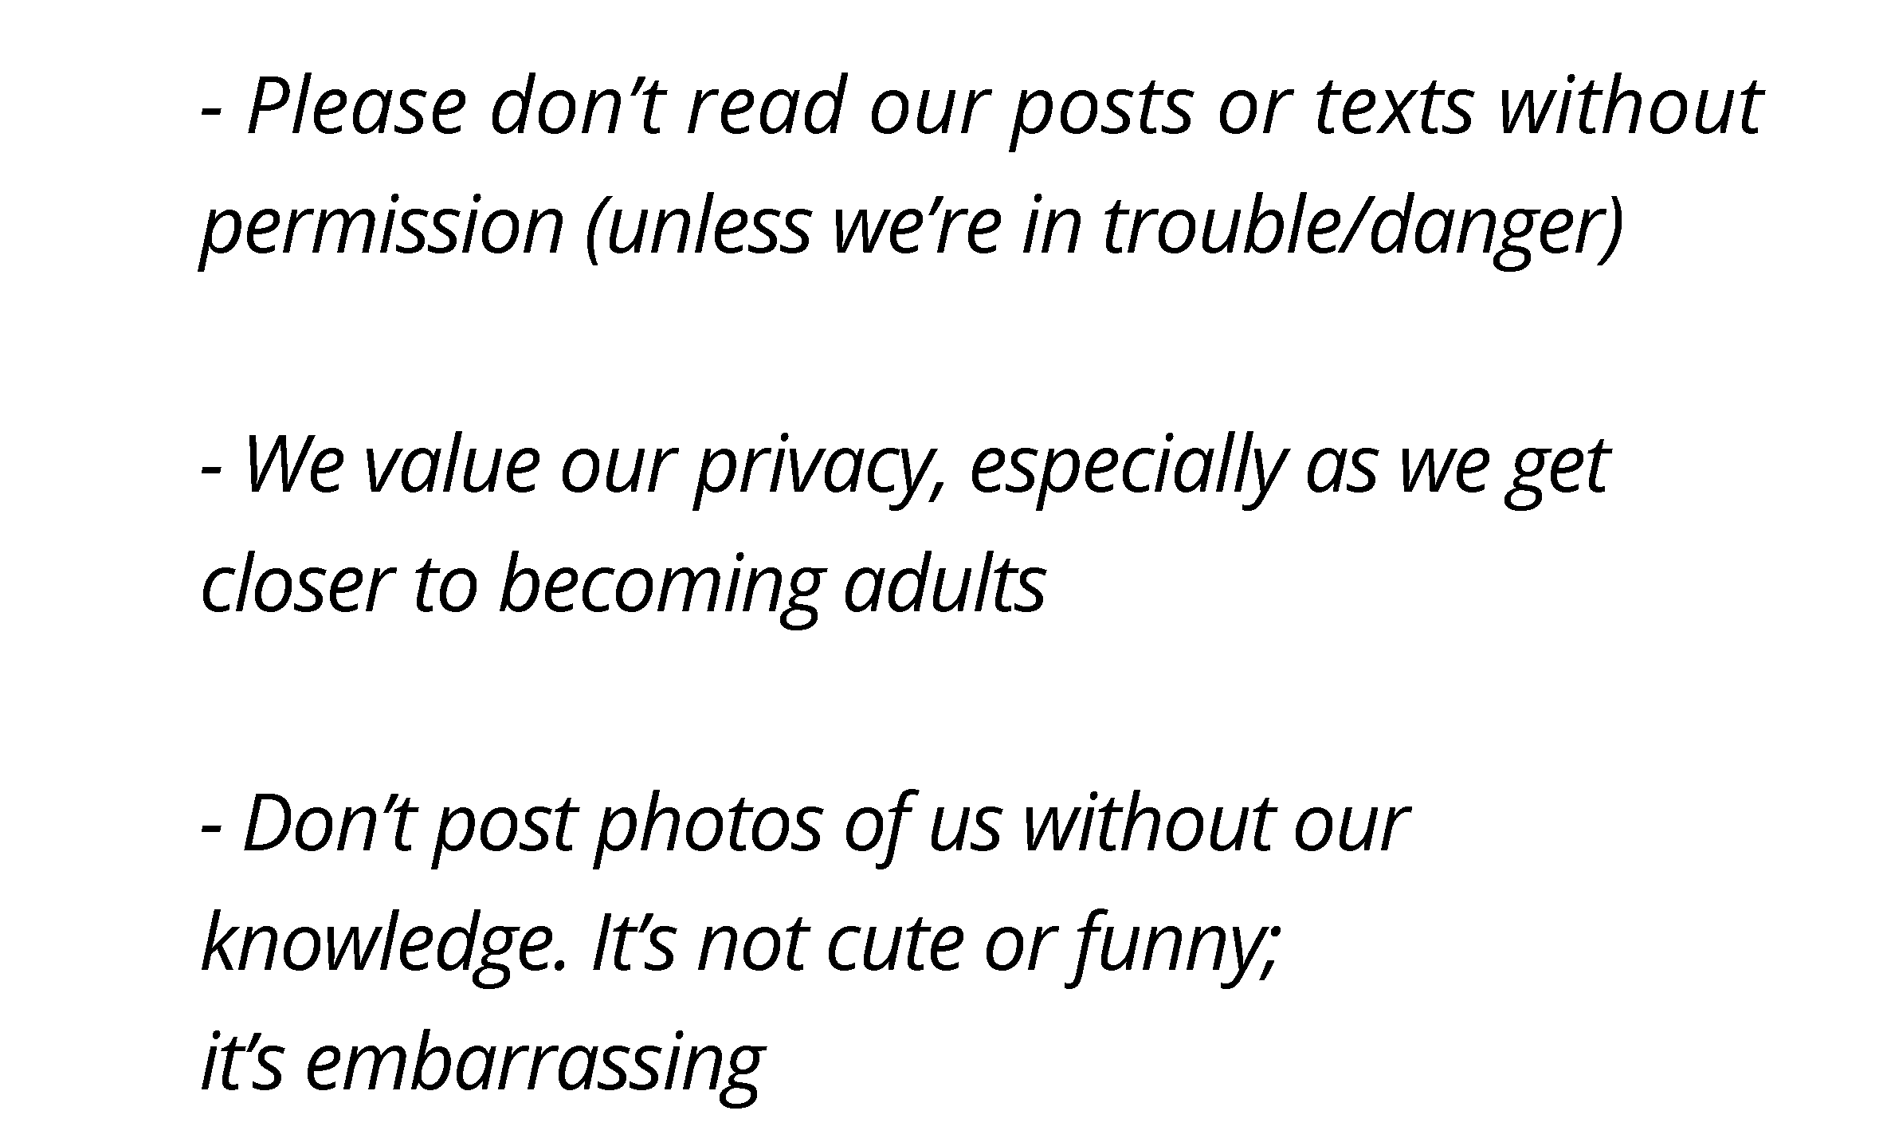
25
Notes:
Teens’ Response -
“Privacy is very important to us. Help us set smart social media guidelines, then trust us.”
Talking Points –
Please don’t read our posts or texts without permission (unless we’re in trouble/danger)
In our survey a majority of respondents said they wished their parents wouldn’t read their posts or text messages.
We value our privacy, especially as we get closer to becoming adults
Many of the students in our Lifesmarts survey said their parents do trust them and their privacy. (60% of our respondents were high school seniors.)
Don’t post photos of us without our knowledge. It’s not cute or funny; it’s embarrassing.
Don’t overshare. They really don’t want parents to share information about them with their explicit permission. According to Sarita Schoenebeck, assistant professor in the University of Michigan’s School of Information and one of the authors of the study, ‘Twice as many children as parents expressed concerns about family members over sharing personal information about them on Facebook and other social media without permission … Many children said they found that content embarrassing and felt frustrated when their parents continued to do it.”
Source: https://www.heysigmund.com/technology-social-media-rules-children-teens-wish-parents-follow/
Often, the posting of photos is likely to be completely innocent, and not intended to make kids squirm, but what many children are telling us, is that for them, it’s crossing a boundary. For our kids, their first experience of establishing their boundaries is with us. We’ll be the first ones to feel the brunt of their ‘no’s’, their resistance, or their experimentation with where their boundaries lie. We want this. We want them to be clear about what feels okay and what doesn’t. When we put their important, sometimes private, moments into the internet stratosphere without asking for their permission, the risk is that we’re teaching them that other people can do the same, and that their boundaries don’t matter.
Source: https://www.heysigmund.com/technology-social-media-rules-children-teens-wish-parents-follow/

Slide 26
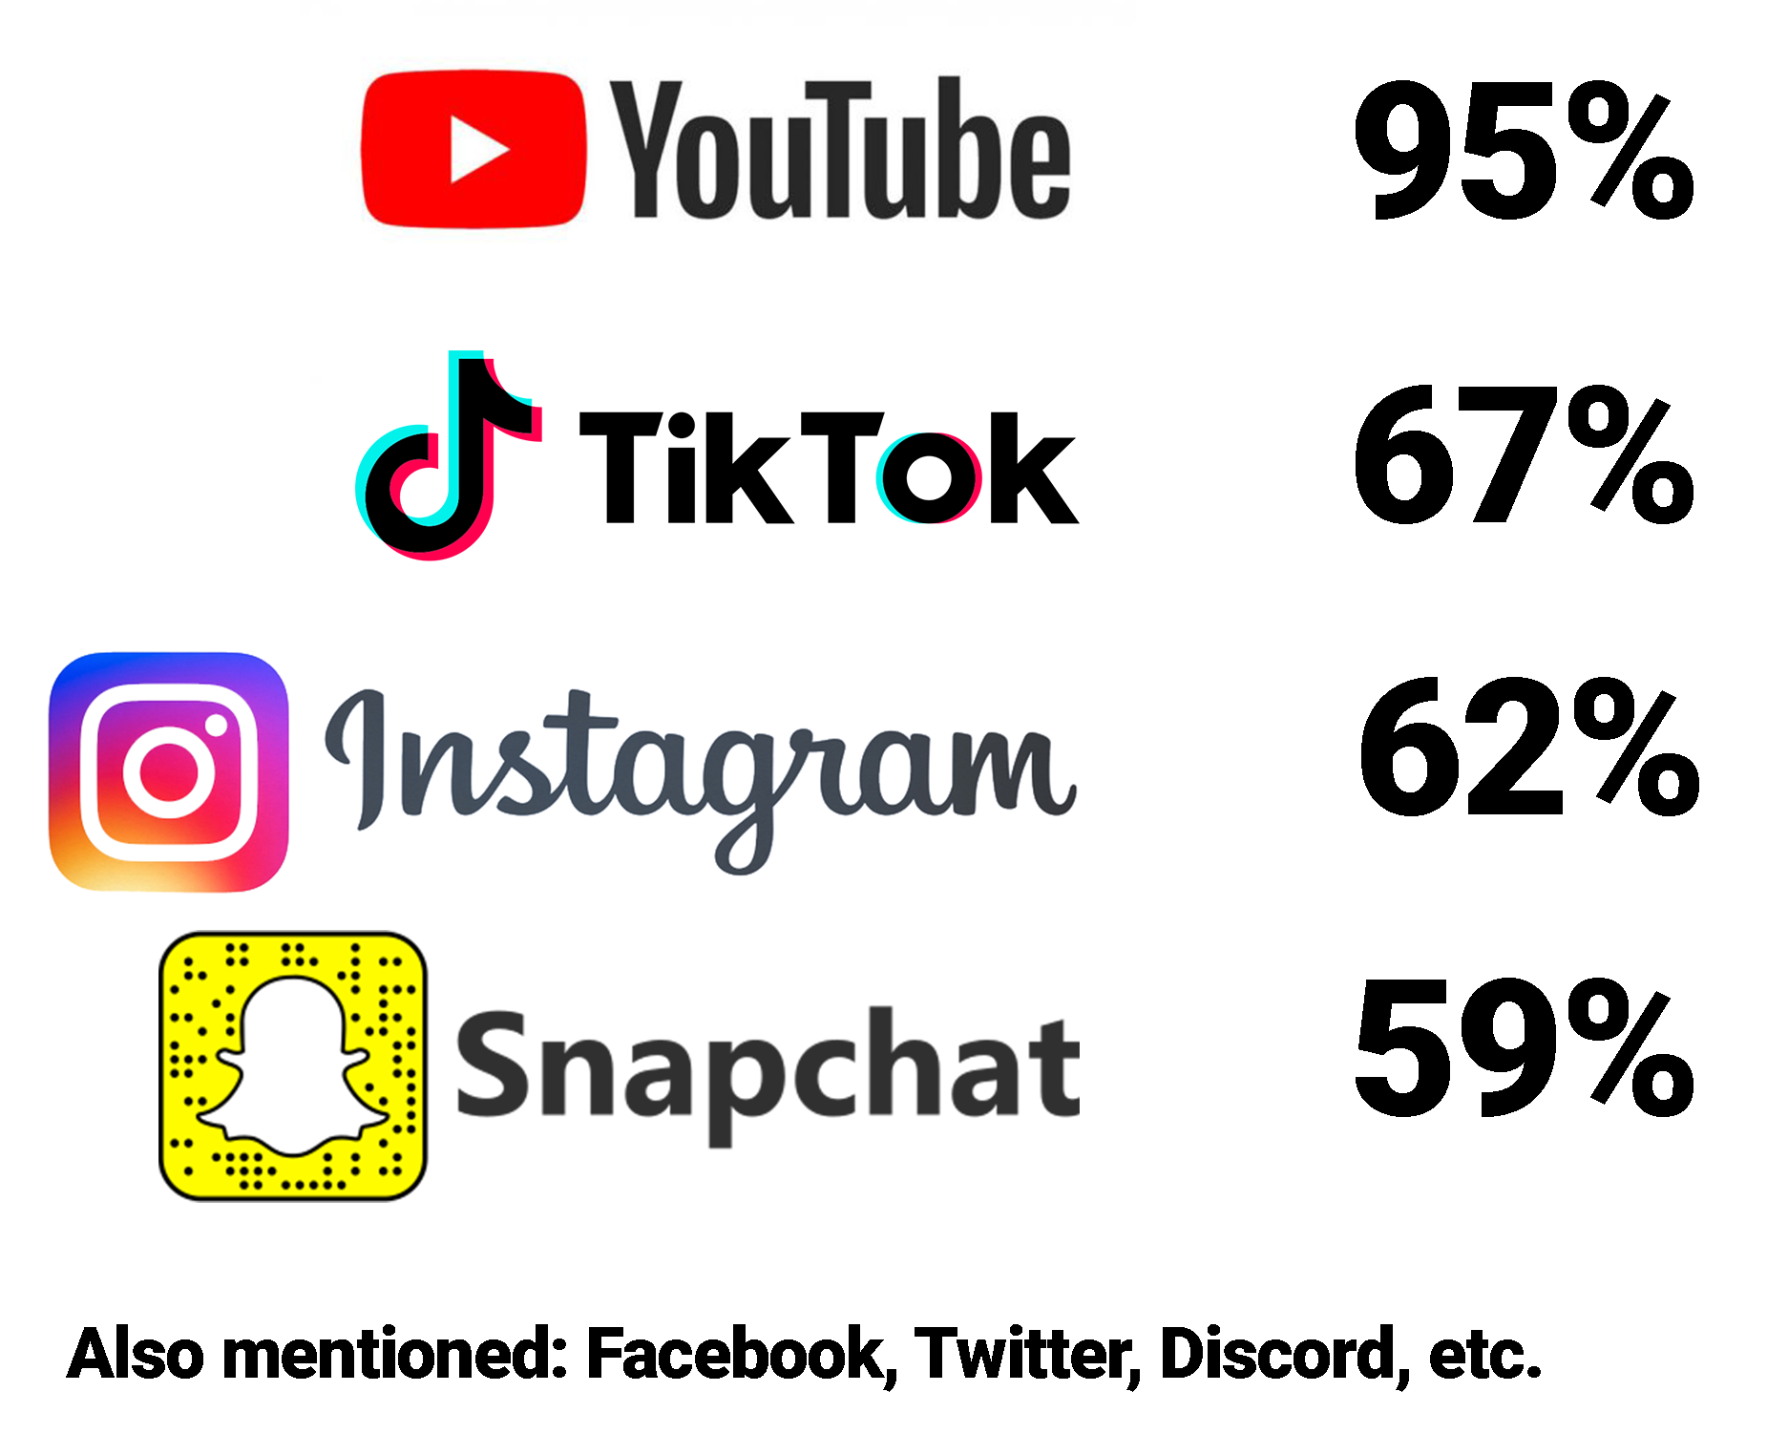
26
Notes:
“My child is wasting their life away on social media”
No doubt you’ve said this to yourself at least a few times.
Talking Points –
You’ll have to ask your own child what their favorite apps are, but these are the most popular. In a survey conducted in April 2022, by Pew Research Center:
95% of all teens report watching videos (or even making videos) for YouTube
67% are on TikTok
62% use Instagram
59% login to Snapchat
You might be surprised to hear that Facebook has dropped all the way down to 32%... with others like Twitter, Twitch, Whatsapp, Reddit, and Discord further behind.
Source: https://www.pewresearch.org/internet/2022/08/10/teens-social-media-and-technology-2022/pj_2022-08-10_teens-and-tech_0-01a/
Full article: https://www.pewresearch.org/internet/2022/08/10/teens-social-media-and-technology-2022/

Slide 27
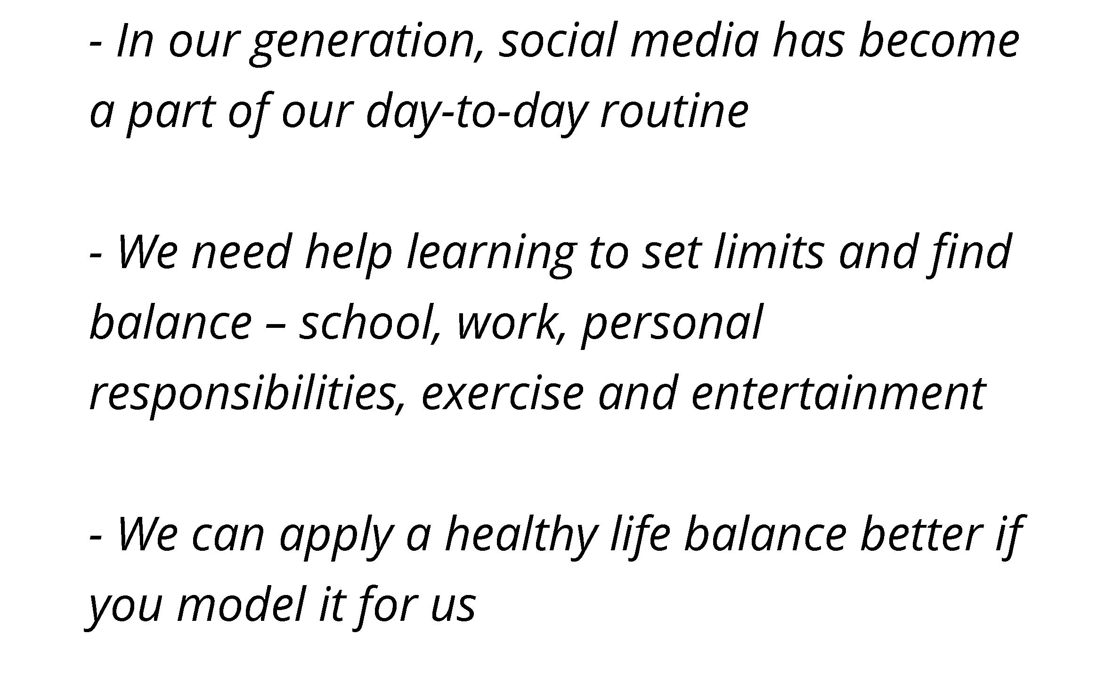
27
Notes:
Teens’ Response -
“Social media is a tool and it has purpose; it allows for interaction, even if it is online.”
Talking Points –
In our generation, social media has become a part of our day-to-day routine
This was a common statement when speaking to students in our focus group meetings. There’s no going back. The internet is here to stay; social media is here to stay; we have to find a way to co-exist peacefully.
We need help learning to set limits and find balance – school, work, personal responsibilities, exercise and entertainment
Child autonomy. Not surprisingly, children would love it if parents allowed children to make their own decisions about their technology use. As parents, we would probably love it too – if we knew it would always end well.
Source: https://www.heysigmund.com/technology-social-media-rules-children-teens-wish-parents-follow/
We can apply a healthy life balance better if you model it for us. If our children had a say, they would ask us to balance our technology use with other activities. This doesn’t necessarily mean our use is out of balance, but it might reflect our children’s needs to have us present and available when they need us (and so we can notice when they need us).
Source: https://www.heysigmund.com/technology-social-media-rules-children-teens-wish-parents-follow/
Practice what you preach. Kids and teens want their parents to practice what they preach, such as putting the phone down when everyone is at the table.
Source: https://www.heysigmund.com/technology-social-media-rules-children-teens-wish-parents-follow/
Advice - “Set up ground rules as a family before you turn them loose. If you do that when they’re small, you don’t argue with a 16-year-old about privacy,” he said. “It will just be a part of your family at that point.”
Source: https://www.washingtonpost.com/lifestyle/style/how-to-protect-kids-online-apps-and-tactics-used-by-experts--and-real-parents/2016/12/07/42ef7f14-ad13-11e6-a31b-4b6397e625d0_story.html?utm_term=.1a1941166374&itid=lk_inline_manual_28

Slide 28
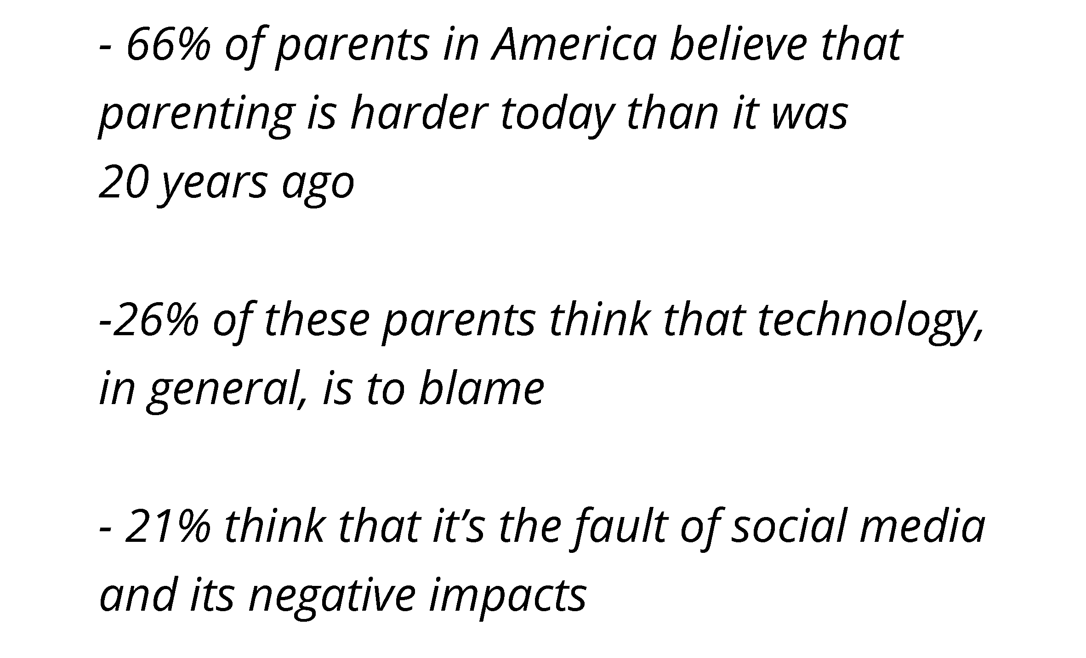
28
Notes:
We hope it hasn’t gotten to this point yet in your family, but –
“I don’t even know my child anymore, they spend so much time on social media” is a comment we’ve heard.
Talking Points –
66% of parents in America believe that parenting is harder today than it was 20 years ago
There’s no doubt that parenting looks different. The internet has opened up so much opportunity… both good and bad. Just because your child is in their room, doesn’t mean they are safe anymore.
26% of these parents think that technology is to blame
Whether it’s cyberbullying or internet addiction, technology seems to follow teens everywhere.
21% believe that social media is at fault
While social media may or may not be part or the problem, it is easy to blame.
Source: https://smartsocial.com/post/social-media-statistics

Slide 29
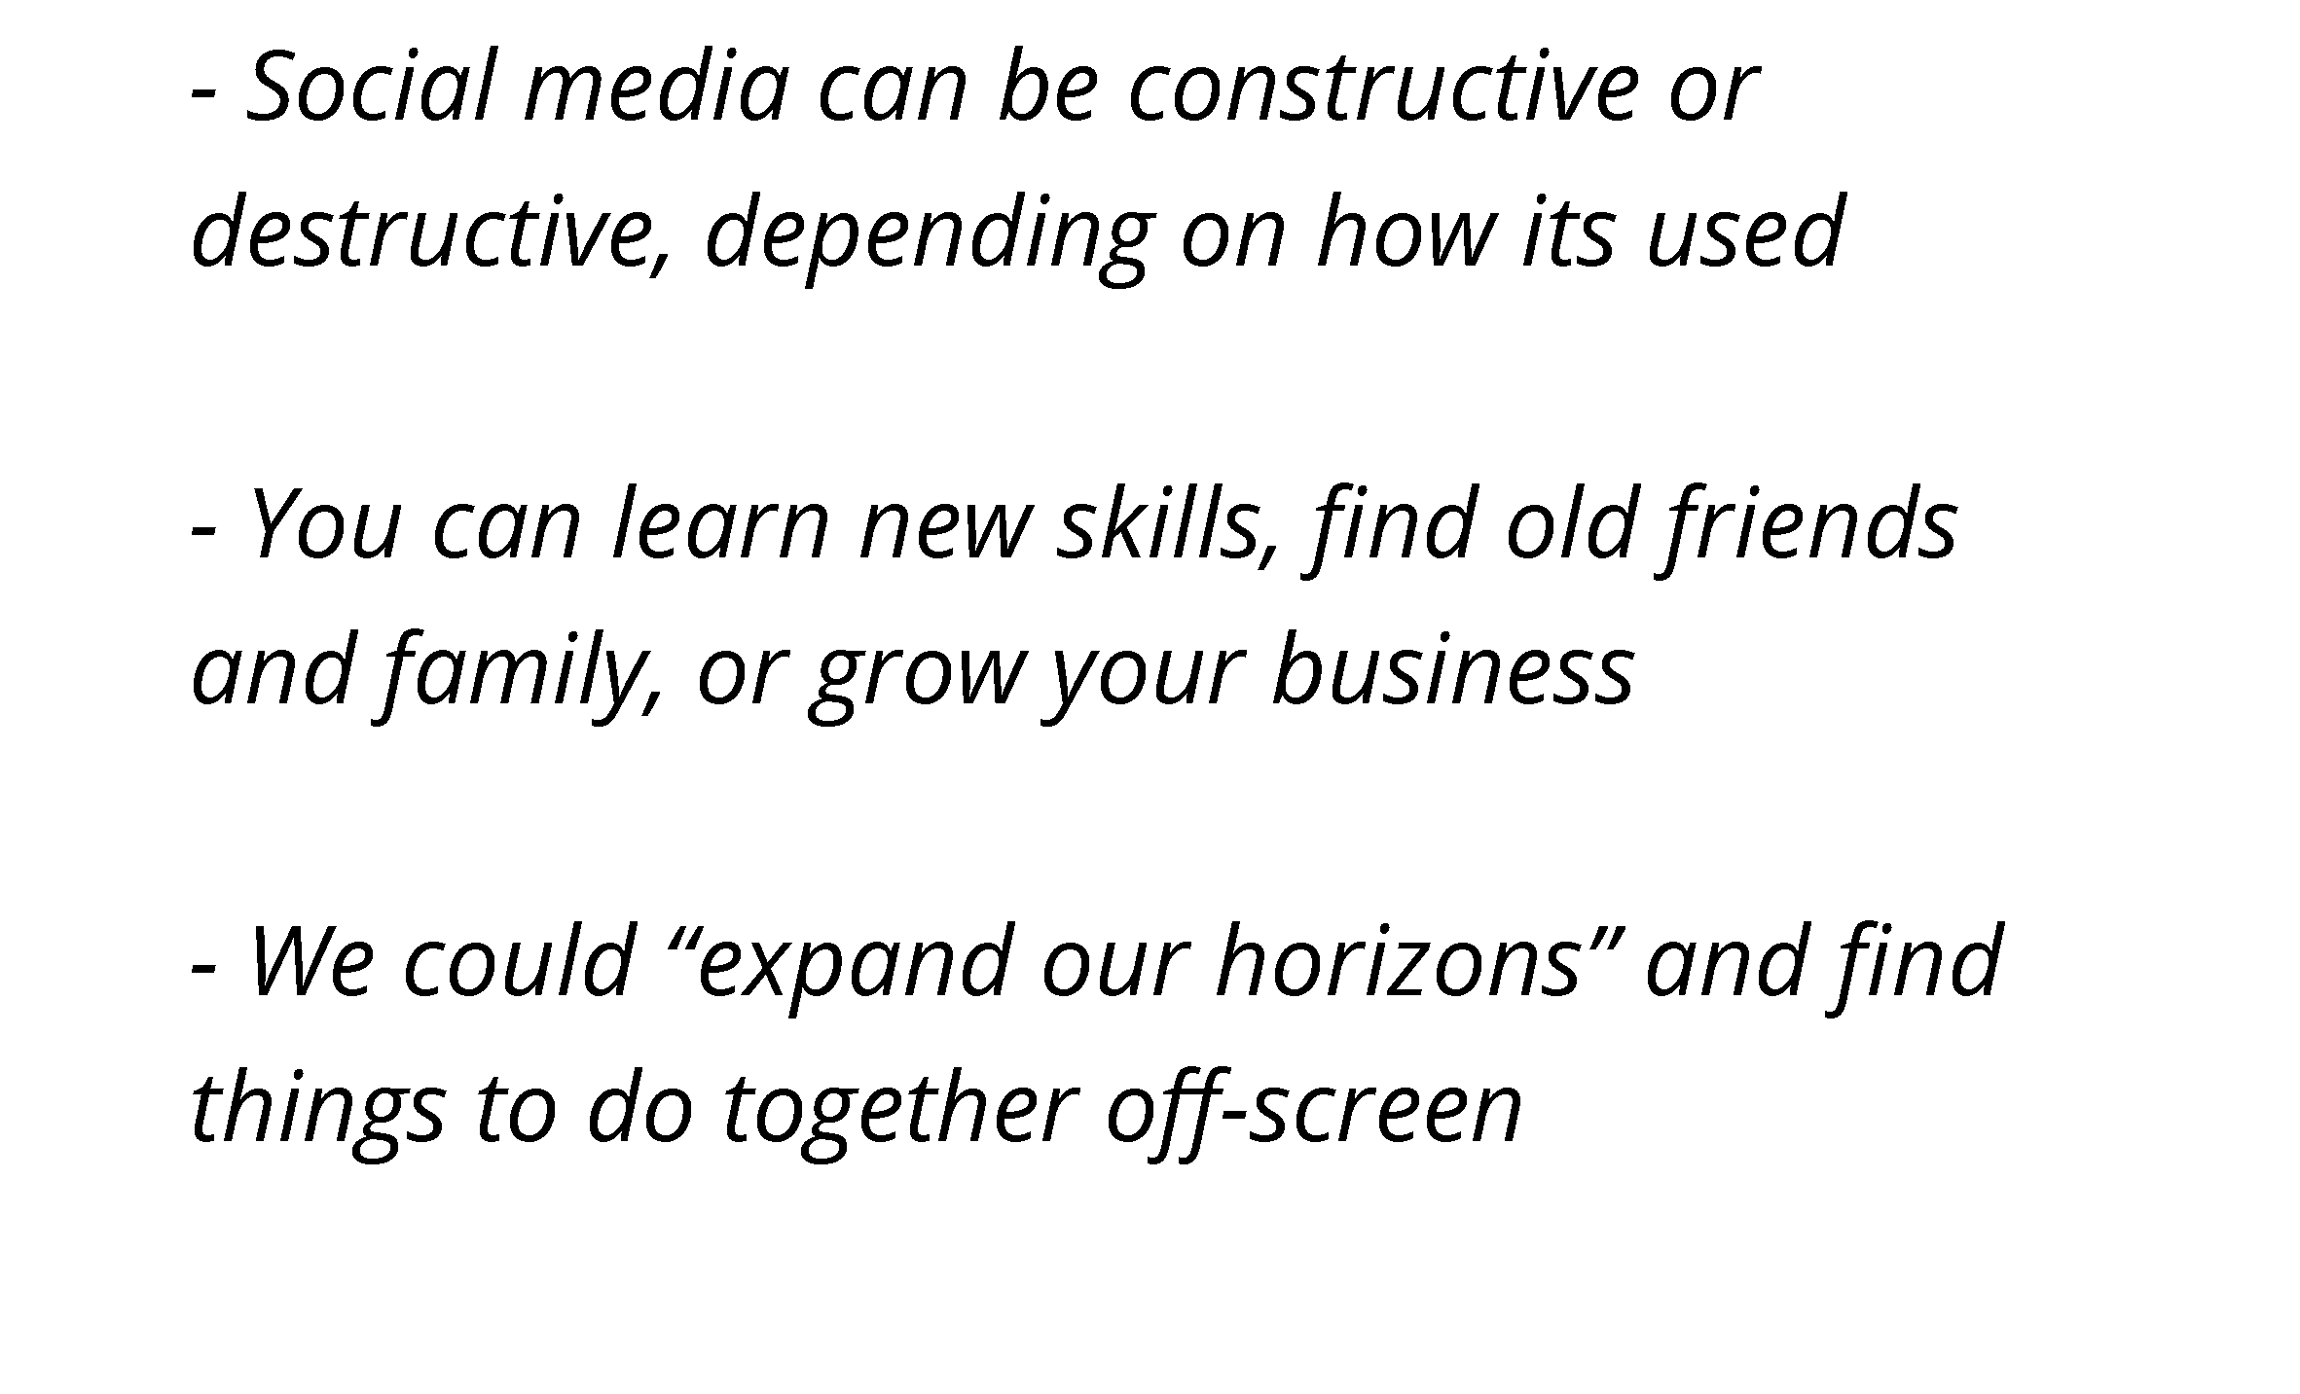
29
Notes:
Teens’ Response -
“Let me show you how you can use social media to benefit your life.”
Talking Points –
Social media can be constructive or destructive, depending on how its used.
Many parents will blame social media because they don’t understand it. They don’t know why kids are drawn to it; they don’t see its value. But by opening the lines of communication and showing interest in the apps, families will be better able to come to agreement on guidelines for social media use.
Be app-savvy. “If your kid is on it, you should be, too,” Homayoun says of apps and social media platforms. “You don’t have to have an account, but at least try it out so you can have informed conversations about it. If your kids know that you understand the social media they’re using, they’re more likely to come to you to talk about issues that pop up.”
Source: https://www.washingtonpost.com/news/parenting/wp/2017/07/11/5-ways-parents-can-help-kids-balance-social-media-with-the-real-world/
You can learn new skills, find old friends and family, or grow your business
Could your business use some new marketing ideas? Your teen can probably help! Hire your teen to be your company’s Social Media Manager.
Do you have a high school reunion coming up? Give your teen your yearbook and see how many alum they can find.
Discover a new family hobby on YouTube and do a summer project together. There are all kinds of possibilities.
We could “expand our horizons” and find things to do together off-screen
Research places to visit… then see them on day trips or summer vacation
Take a virtual tour of colleges to narrow down your list of schools to visit/apply to
The most important tool to keep from falling into the screen trap? Conversation. Lots of conversation. That, parenting experts say, should be the first line of defense. “Our kids are digital natives, and we’re digital immigrants,” said Deborah Gilboa, a family physician and parenting expert based in Pittsburgh. A mother of four, she asks her own 14-year-old for help. She went to him, for example, to school her on Snapchat and how to use it.
“Acknowledge that kids are more expert than you are,” Gilboa said. “We really teach them something valuable when we respect them enough to ask them about it.”
Source: https://www.washingtonpost.com/lifestyle/style/how-to-protect-kids-online-apps-and-tactics-used-by-experts--and-real-parents/2016/12/07/42ef7f14-ad13-11e6-a31b-4b6397e625d0_story.html?utm_term=.1a1941166374&itid=lk_inline_manual_28
Family Challenge - “Talk with us about the apps we like to use and why. Most of you have no idea about our world.” Ask your kids which apps they spend the most time on. Download those apps and spend time learning the ins and outs.
https://www.washingtonpost.com/news/parenting/wp/2018/01/09/what-teens-wish-their-parents-knew-about-social-media/

Slide 30
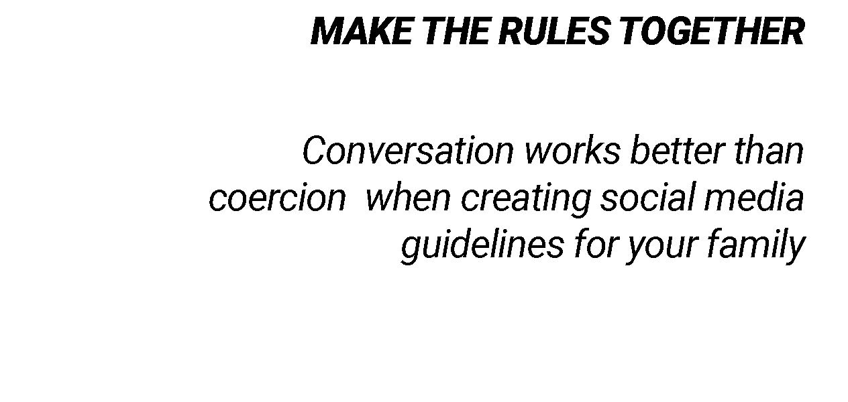
NEXT STEPS
30
Notes:
No matter how you feel about social media, it isn’t going away.
So the key is, how do we live peacefully in a technology-filled world?
1/ MAKE THE RULES TOGETHER
Conversation works better than coercion when creating social media guidelines for your family
Talking Points –
We don’t want kids growing up feeling scared of a world that can hurt them, but the truth is, that world is there. Children and teens will often be blind to these threats, which can make the dangers worse. This is where parents come in.
Having rules around technology and social media use is important, but as much as we can, we want them to understand and agree with the rules. When the rules make sense to them, they’ll be more likely to internalize those rules and follow them even when their parents aren’t watching – which is most of the time.
It’s impossible to constantly know what kids are doing online. When they follow rules because they believe the rules make sense, rather than to stay out of trouble, it’s more likely that they will stay compliant, even when they have the opportunity to do otherwise. One of the best ways to make this happen is to involve them in making the rules.
Set clear ground rules. Talk to your kids about appropriate social media use before you give them a phone or allow them to download a new app, says Homayoun. “Once you hand it over, they’ll be too excited to focus on your instructions.” Clearly state rules and expectations, and stick with them as much as possible.
Source: https://www.washingtonpost.com/news/parenting/wp/2017/07/11/5-ways-parents-can-help-kids-balance-social-media-with-the-real-world/

Slide 31
MAKE THE RULES TOGETHER
NEXT STEPS
Conversation works better than coercion when creating social media guidelines for your family
SAFETY FIRST/GET APP-SAVVY
Protecting your private information is a priority. When in need, ask your kids, the digital experts, for help
31
Notes:
When you’re making the rules, keep safety first.
2/ SAFETY FIRST / GET APP-SAVVY
Protecting your private information is a priority. When in need, ask your kids, the digital experts, for help
Talking Points -
Lean on your teen to explain how to change your privacy settings (if you don’t know how).
Come to an agreement on what information should not be shared online.
“If your kids know that you understand the social media they’re using, they’re likely to come to you to talk about issues that pop up.”
Be genuinely interested in their online life… not in a nosy, or annoying way… but in a way that shows “what interests them is important to you.”
“There’s something else we need to remember whenever we’re setting rules for our kids about social media, particularly for older kids: They often know the territory better than we do. Although there will be risks they will be blind to, there might also be ones that we’re blind to. We need them involved in the conversation, because we need to learn from them, especially if we want them to learn from us. We need to ask them what they think the biggest risks are, and we need to listen. We also need to ask them what they think about the risks we see, and we need to listen. In their answers, will be the reasons they don’t think the rules are important. This will be the things they’ll tell themselves to make it okay to break the rules. Then we need to ask them again next month, because the landscape is changing so quickly out there.
We encourage parents to ask a lot of questions. Ask them to teach you things. Show you things. Be genuinely interested in their online life. We bet you’ll learn a bunch of new things about your child.”
Source: https://www.heysigmund.com/technology-social-media-rules-children-teens-wish-parents-follow/

Slide 32
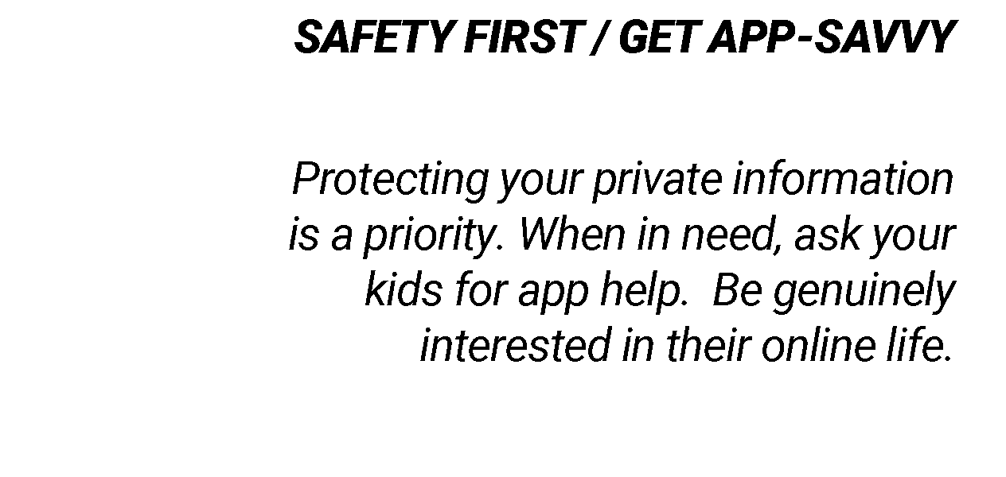
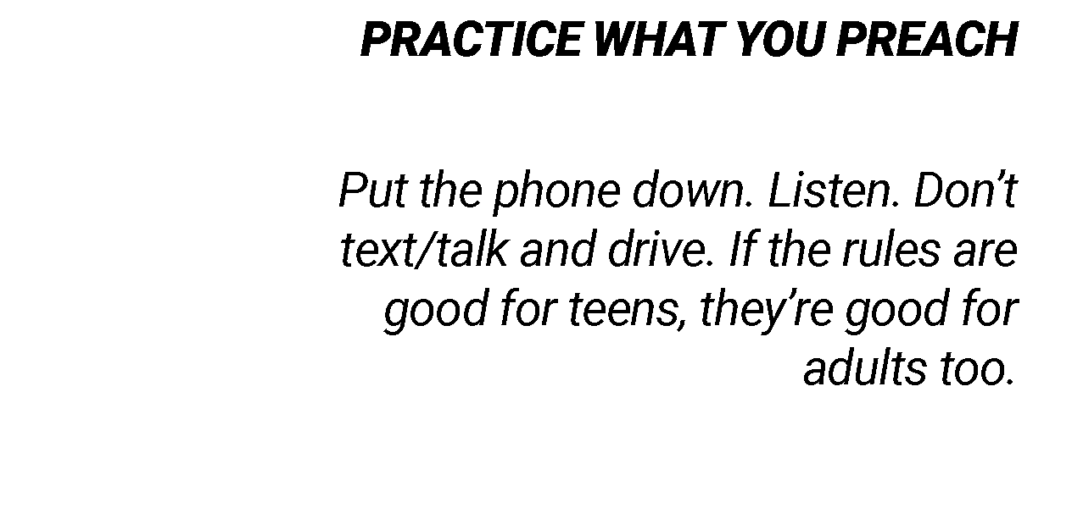
NEXT STEPS
32
Notes:
3/ PRACTICE WHAT YOU PREACH
• Put the phone down. Listen. Don’t talk/text and drive. If the rules are good for teens, they’re good for adults too.
Talking Points -
• It’s important to model the right behavior yourself: No screens at dinnertime, phones away when you should be talking to each other, and set a time that everyone puts their devices down at the end of the day.
Be Present. Our children want us to put our phones away when they need us, such as when they’re talking to us. It’s just the way it is that if we want them to talk to us about the important stuff (and it’s all important to them), we need to be ready when they are.
Source: https://www.heysigmund.com/technology-social-media-rules-children-teens-wish-parents-follow/

Slide 33
33
Notes:
Conclusion
Consider the talking points below and offer a personal conclusion “from the heart” in which you encourage the audience to talk to their kids and open up lines of communication about social media.
Thank your audience for their attention.
And (if you are willing) open the floor to any questions.
Talking Points -
If we want teens and tweens to adopt better habits and healthier choices online and in-real life, we have to change how we talk about the social world, both online and in-real-life. In the end, promoting social media wellness is all
about developing awareness and encouraging open communication, because teens who perceive their parents are unaware are less likely to seek their parents’ guidance and support in times of need — and that’s not a secret we want them to keep.
https://www.washingtonpost.com/news/parenting/wp/2018/01/09/what-teens-wish-their-parents-knew-about-social-media/

