Slide 1
Laundry 101
What do You Know about Laundry and Care Labels?
Presented by LifeSmarts, consumer education for teens

Slide 2

LifeSmarts is a program of the National Consumers League
Notes:
A program of the National Consumers League, the goal of LifeSmarts is to create financially literate youth who are empowered consumers, workers, and citizens.

Slide 3
Products and Processes
Cleaning clothes isn’t just about stuffing them in the washing machine and walking away.
Understanding laundry products and the laundry process can help in choosing the right cleaning products and keep clothes looking their best longer.

Slide 4
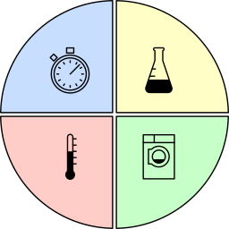
Cleaning anything revolves around four factors:
  Mechanical energy
  Chemistry
  Temperature
  Time
Sinner’s Circle
Notes:
In 1959 Dr. Herbert Sinner, a German chemical engineer illustrated the cleaning process as a circle with four sectors representing chemicals, mechanical action, temperature and time. Sinner's Circle is still used when describing cleaning processes and how varying the size of some sectors will affect the other sectors.
For example, a power washer uses mechanical energy as the predominant factor, while soaking a greasy BBQ grill in vinegar uses time and chemistry primarily. All four factors are considered when developing cleaning chemicals and washing machines.

Slide 5
Washing Machines
There are many kinds of washing machines, but they fall into three basic categories.

Slide 6
A frontload machine lifts items up as the drum rotates and drops them into the water.
For all types of washers labeled high efficiency (HE) it is important to use HE detergent.
Frontload
Washer
Notes:
A HE washer needs a HE detergent because they are formulated to be low-sudsing.
Since HE washers use significantly less water, HE detergents are designed to be rinsed out with less water.

Slide 7
Considered the “standard” washer, top load washers have a spindle (agitator) in the center of the drum to move clothing and water.
Top Load Washer-Agitator
Notes:
For top load washers, fill your washer with your laundry and turn the machine on and add detergent once the machine has filled with water.

Slide 8
This HE washing machine uses low profile discs or cones to help the textiles rub against one another in the drum.
Top Load Washer-Impeller

Slide 9
Detergents
Made from specially formulated surfactants and other chemicals, detergents are designed to clean efficiently, but ALSO to solve laundry problems.
Notes:
Detergents are a combination of chemicals that can perform a variety of functions. However, choosing the right one can be tricky.

Slide 10
Scientifically formulated to accomplish a variety of tasks, detergents:
  Control odor
  Treat spots and stains
  Safeguard sensitive skin
  Protect delicate fabrics
  Whiten laundry or brighten colors
Scientifically Formulated
Notes:
This is one of the reasons there are so many products to choose from.

Slide 11
The laundry aisle at the grocery store stocks detergents that do all these things and most come in the following forms:
  Powder
  Liquid
  Packets
  Sheets
Different Forms
Notes:
The laundry industry has changed dramatically over the past two decades and is now a science-based multi-billion-dollar industry.

Slide 12
Powders – tough on heavy soil and come in eco-friendly cardboard packaging
Liquids – good for grease and oil as the liquid penetrates the fibers easily; can also be used to pretreat stains
Packets – convenient, pre-measured so cannot be overused
Sheets – eco-friendly, cannot overuse, and space saving
Advantages of Each Type
Notes:
Many consumers also keep the environment in mind when buying laundry products.

Slide 13
You don’t need all types of laundry products, but think about what is most important to you
Consider detergent form, function, cost, convenience, and eco-friendly options
Buy what you need
Choices, Choices, Choices
Notes:
If you love to exercise, consider the odor control detergents, while if you love vintage clothes, you might need a detergent for delicates.

Slide 14
How Much Detergent to Use?
The amount of detergent depends on several factors:
  HE or traditional washer
  Soil level of clothing
  Size of the load
  Water hardness
  Type of detergent being used
It is important to dose correctly, since under- or over-dosing can result in poor cleaning and stain removal.
Notes:
Evaluate each individual load and dispense detergent accordingly

Slide 15
HE machines use less water, so require less detergent
The more soil = more detergent
More detergent doesn’t necessarily mean cleaner clothes
General Rules
Notes:
One packet cleans a medium load, while two are generally need for large loads

Slide 16
Read the label
Follow instructions for dosing on powdered and liquid detergents
Use the dosing cup provided with for powdered and liquid detergents
Read and Follow Directions
Notes:
More is not better and most consumers use too much laundry detergent.
Note the number of loads listed on the laundry detergent the container. While that number is approximate, it is based on measuring with the dosing cup.

Slide 17
Detergent Chemistry
Where does the stain go? How does detergent work?
Doing laundry is a scientific process.
Notes:
For more, visit: https://www.washingtonpost.com/brand-studio/tide/the-science-of-laundry/

Slide 18
What makes detergent work?
  Surfactants – cleaning agents that loosen soil and keep them suspended in wash water
  Enzymes – break down stains and protect colors
  Anti-redeposition agents – prevent soil from being reattached to textiles as they are washing
Scientific Processes

Slide 19
What else makes detergent work?
  Foam regulators – inhibit suds, especially important in front load washers
  Disinfectants – germicide that destroys bacteria and other germs, like viruses
  AOB – activated-oxygen bleach, a bleach that is suitable for whites and colorfast textiles
Scientific Processes

Slide 20
Laundry
Steps
Check care labels for any garments in question
Prep garments:
  close zippers
  check pockets
  pretreat stains
Sort
Add detergent and load machine
Unload and dry

Slide 21
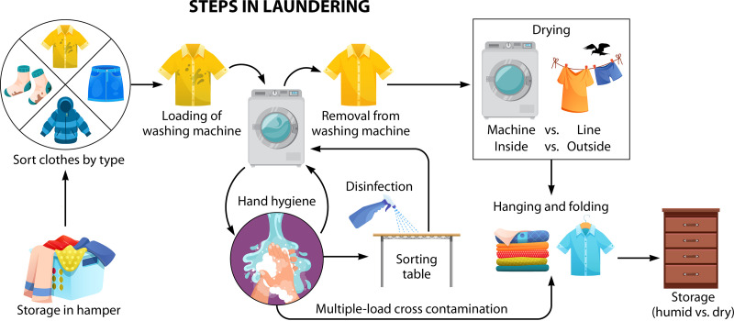
Steps in Laundering
Notes:
Graphic used courtesy of Tide.

Slide 22

High Efficiency, HE
Vocabulary
Washers designed to use less water and less energy than the traditional washer; abbreviated ‘HE’
Notes:
Knowing what type of washer you are using is basic to the detergent purchased and used. Too much or too little detergent both create laundry issues.

Slide 23
Energy Star
Vocabulary
The U.S. Environmental Protection Agency certification that a product has met high levels of energy efficiency

Slide 24
For Our
Environment
  Turn to COLD.
  Using cold water is better for the environment, still cleans your clothes and will save a bit of money.
  What’s not to like?

Slide 25
For
Safety’s
Sake #1
  Laundry detergents should NOT be stored in decorative containers.
  Laundry detergents are chemicals and need to be stored in the original packaging.

Slide 26
For
Safety’s
Sake #2
  Poison center contact information and first aid steps are outlined on detergent packaging.
  Keep child resistant laundry detergent packaging closed and out of the reach of children.
  Detergent can also be harmful to pets.

Slide 27
For
Safety’s
Sake #3
  As for the Pod Challenge that became famous on social media… What about dangerous and stupid do you not understand?

Slide 28
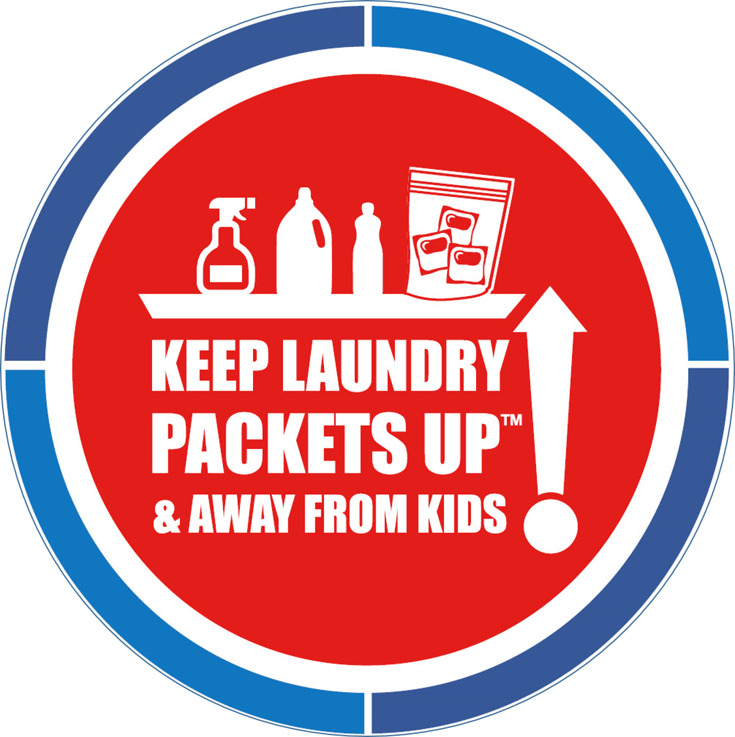
Notes:
Graphic used courtesy of ACI (American Cleaning Institute)

Slide 29
Care Labels

Slide 30
Caring for your Clothes
Some clothing purchases are an investment, such as specialty sports wear, a winter coat or a wool sweater.
Proper care protects the garment and the investment, making sure the garment looks good and wears well for multiple years.
Notes:
According to the EPA, the main source of textiles in municipal solid waste (MSW) is discarded clothing.
Care labeling helps consumers consider the care method required when selecting clothing and textiles. This can reduce loss and complaints from inappropriate cleaning methods.

Slide 31
A care label is a permanent label or tag, containing regular care information and instructions, that is attached in a way that it will not become separated from the product and will remain legible during the useful life of the product
Established by the Care Labeling Rule
Enforced by the Federal Trade Commission (FTC)
What is a Care Label
Notes:
The U. S. requires manufacturers and importers to provide a permanent care label on apparel that provides care instructions and warnings for any care that may have a harmful effect.

Slide 32
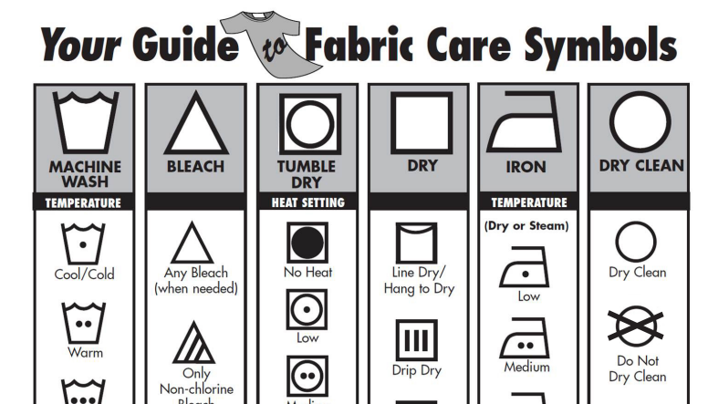
American Care Labeling Symbols system provided by ASTM International
These pictograms are often found on care labels
Care Symbol Pictograms
Notes:
Manufacturers and importers may use words in English, ASTM care symbols, or both. Some instructions, may be reported as a symbol and reported in words.
Graphic used courtesy of ACI (American Cleaning Institute) – the full image is on the next slide.

Slide 33
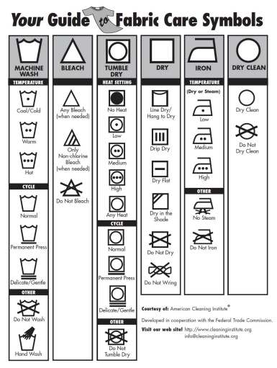
Notes:
Graphic used courtesy of ACI (American Cleaning Institute)

Slide 34
Look for the basic five symbols, and dots, bars and x’s
Apply the simple rules:
  more dots = more heat
  more bars = more gentle
  an X = do not
Care Symbols Decoded
Notes:
Care labeling is based on five basic operations: washing, bleaching, drying, ironing and dry cleaning.
The order of the symbols on a garment care label follow the order of consumer care: washing, bleaching, drying, ironing, and dry cleaning.

Slide 35
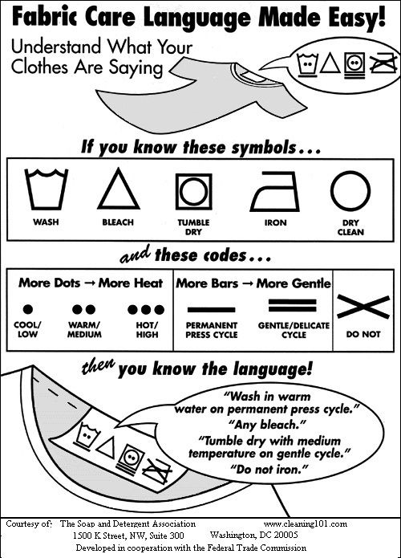
Notes:
Graphic used courtesy of ACI (American Cleaning Institute)

Slide 36
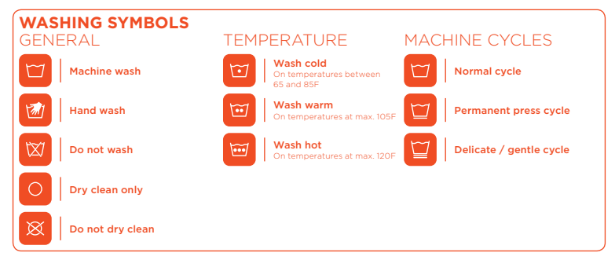
Washing Symbols
Notes:
Washing pictographs are easy to understand and use.
You can observe that they include codes, as well as the symbols.
Graphic used courtesy of Tide

Slide 37
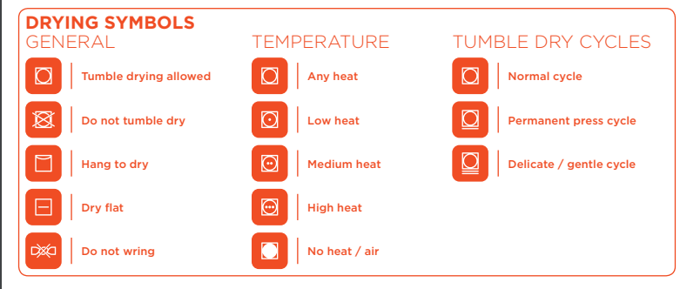
Drying Symbols
Notes:
Drying requires care on some garments. Dry flat and hang to dry symbols indicate do not put in the dryer.
Graphic used courtesy of Tide

Slide 38
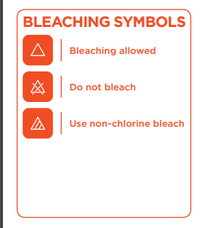
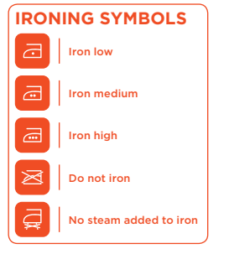
Bleaching and Ironing Symbols
Notes:
Make sure when using bleach, to read the directions for amount, and when and how to add to the wash cycle.
Graphic used courtesy of Tide
You might think iron, who irons? But some specialty fabrics, uniforms and cottons can occasionally need a touch-up.
Some garments call for dry cleaning, which will be indicated on the label.

Slide 39
Read Care Labels for “Dos” NOT “Don’ts”
As you come to understand the care symbols and codes you may recognize that care labels tell you what to DO when caring for a garment
They do not always include what NOT to do
Final Word about Care Labels
Notes:
Eventually, almost everyone ruins a garment doing laundry. This most often happens because they did not read the label or made the assumption the label would state the “don’ts.”

Slide 40
Now
You
Know
Taking the responsibility to care for the clothes you own is a good investment in the items you purchase and enjoy.
Caring for textiles means understanding care labels, laundry symbols and codes.
Doing laundry is easy if you know a few facts and the steps in the process.

Slide 41
About LifeSmarts
LifeSmarts is the nation’s premier consumer education program teaching teens and tweens important real-life information.
LifeSmarts:
  Hosts online and live competitions
  Provides free teaching resources
  Offers opportunities for students including teamwork, leadership, and community service
  Is a scholarship program
www.LifeSmarts.org
Notes:
LifeSmarts is a comprehensive consumer education program that is free to middle school and high school students and educators. The main goal of the program is to create consumer savvy young people who will be better equipped for adult life in today’s complex, global marketplace.
LifeSmarts focuses on:
Personal Finance
Consumer Rights & Responsibilities
Health & Safety
Technology & Workforce Preparation
The Environment

Slide 42
Thank you
LifeSmarts thanks TIDE for the financial support to develop this lesson.

