Slide 1
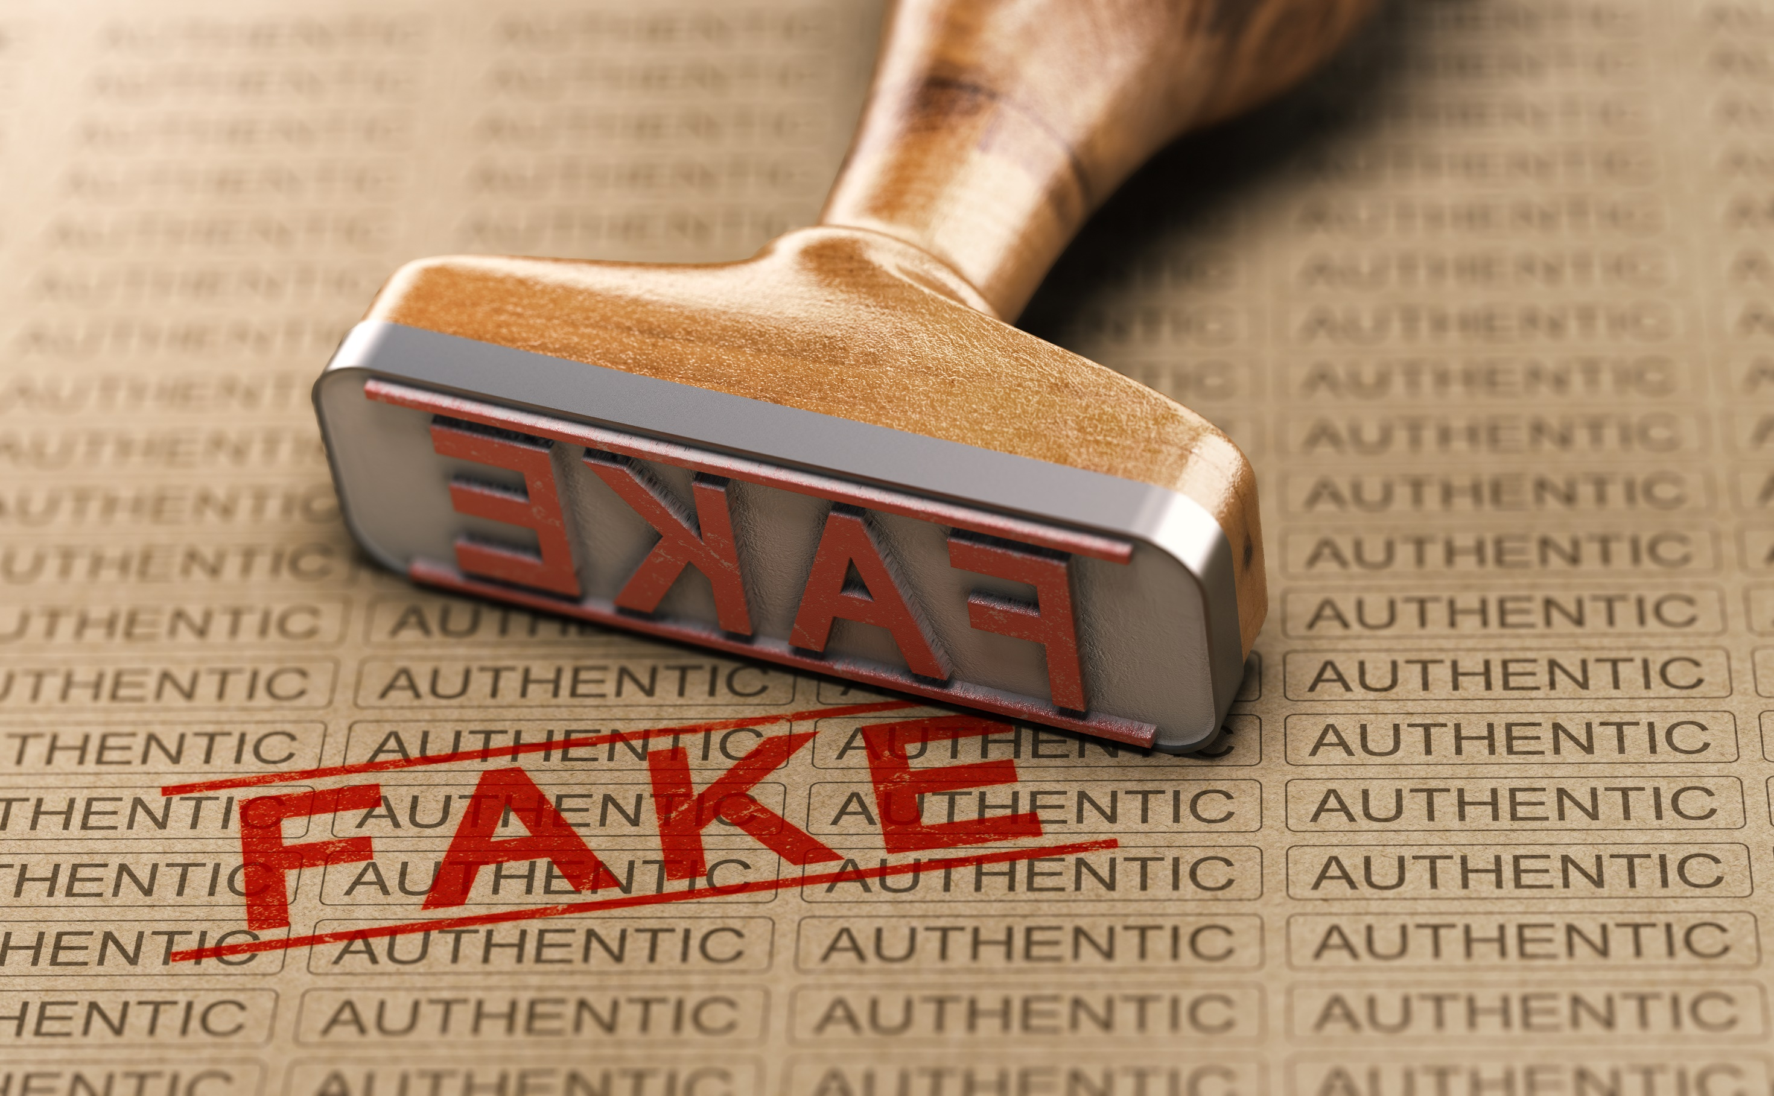
Counterfeit Products
What consumers can do about fakes in the marketplace
Presented by LifeSmarts, consumer education for teens

Slide 2

LifeSmarts is a program of the National Consumers League
Notes:
A program of the National Consumers League, the goal of LifeSmarts is to create financially literate youth who are empowered consumers, workers, and citizens. Visit LifeSmarts.org to explore more free resources.

Slide 3
What’s a counterfeit?
Counterfeit products are designed to look just like a name-brand product. In some cases consumers may believe the products are genuine, and in other cases consumers know the products are fake.

Slide 4
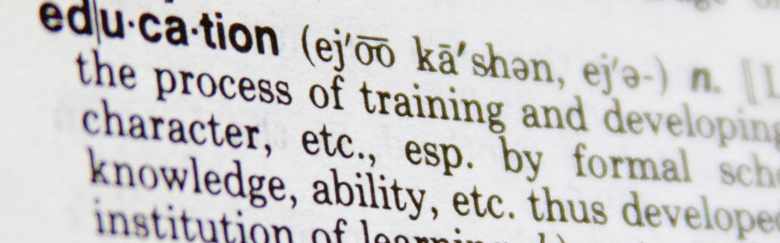
Counterfeit
Vocabulary
An item that uses someone else’s trademark without their permission; an imitation intended to deceive

Slide 5
Why does it matter?
Counterfeit products cause harm. They:
Threaten your health and safety
Waste your money on inferior products
Steal a company’s Trademark or Intellectual Property (IP)
Fund other criminal activities
Consumer awareness is key to combatting counterfeit products in the marketplace.

Slide 6
Just the Facts
Young consumers buy more counterfeit products than other consumers
The availability of counterfeit products is exploding
The internet has spurred the growth in counterfeit goods
Counterfeit products are dangerous

Slide 7
You’ve seen counterfeit products hyped on social media as replicas, knockoffs, and dupes.
How does calling an item a “dupe” or “rep” make a counterfeit product sound legit?
What do you think?
Notes:
“As we were studying the effects of the internet and the growth of e-commerce and social commerce, some of my students suggested that we needed to look into so-called “dupes” (duplicates) and “reps” (replicas) on social media. They were being used in a way that made them sound more acceptable and less criminal than a counterfeit.” -- Jay Kennedy, Michigan State University
https://besafebuyreal.ul.org/resource/social-media-counterfeits

Slide 8
Humans are complex:
Social influencers have credibility and when they market dupes or reps the products seem legitimate
Over time we justify buying fakes because “everyone else does”
Name-brand products, even fake ones pretending to be real, might give us a sense of belonging
We might believe that dupes and reps are different, but not counterfeits
Some Answers

Slide 9
Knockoff
Vocabulary
A product that closely resembles a brand name but is not identical

Slide 10
Replica
Vocabulary
A new term used by counterfeiters to describe items that are identical or very similar to brand name products, especially used by social media influencers to describe shoes and handbags

Slide 11
Dupe influencer
Vocabulary
A social media influencer who reviews, promotes, and links to counterfeit products
Notes:
A social media influencer is someone who reviews, promotes, and links to

Slide 12
In today’s social media saturated world, influencers have become a powerful force.
How do dupe influencers help us rationalize that it’s OK to buy counterfeits?
What do you think?

Slide 13
Dupe influencers use the psychology of influence to:
Provide social proof (if everyone is doing it, it must be OK)
Serve as the voice of authority and guide consumer buying choices
Create a sense that you can be unique yet also belong
Connect with their followers and gain their trust
Some Answers

Slide 14
The Top 10
The 10 most counterfeited products are:
Shoes/footwear
Clothing and textiles
Leather goods
Electrical machines and equipment
Watches
Medical and photographic equipment
Perfumes and cosmetics
Toys
Jewelry
Medicine
Notes:
https://besafebuyreal.ul.org/sites/default/files/2020-09/UL_WACW_Infographic_Top10.pdf

Slide 15
The Marketplace
Most people buy counterfeits unknowingly, either through a dishonest source, or through an honest source that has also been duped. Counterfeit products are sold through:
Online marketplaces and brick-and-mortar stores
Reputable companies
Deceptive product websites
Dishonest suppliers
The gray market
Flea markets and street vendors

Slide 16
According to Red Points, 43% of young consumers have bought a fake item, and about 20% knew they were buying a fake.
Why are young people the most likely to buy counterfeit products?
What do you think?
Notes:
https://www.redpoints.com/blog/young-consumers-fake-fashion-online/

Slide 17
Young consumers’ buying habits make them more likely to buy counterfeits:
They want name-brand products they see on social media
They want a “great deal”
They have limited money to spend
They may not know the dangers posed by counterfeit goods
They may be indifferent to the issues of counterfeit products
Some Answers
Notes:
https://besafebuyreal.ul.org/sites/default/files/2021-11/BSBR%20Youth%20Day%20Infographic-Final.pdf

Slide 18
Gray market
Vocabulary
The sale of genuine products that are diverted from authorized distribution channels and sold by third-party vendors

Slide 19
Third-party seller scam
Vocabulary
Schemes devised by some independent sellers to defraud shoppers by selling fake products through popular online marketplaces

Slide 20
One expert responded, “internet, internet, internet” when asked why counterfeit products are seemingly everywhere.
What are some signs that a website is mimicking another brand in order to sell counterfeit goods?
What do you think?

Slide 21
Signs that a website may be fake:
Bad grammar and typos
Contact email address is a free account (like Gmail or Yahoo) and not a company account
It was created in the last few weeks
The URL does not begin with https
You clicked an unsolicited link to get there
Domain name misspelled
Some Answers
Notes:
https://besafebuyreal.ul.org/sites/default/files/2020-11/7-critical-tips-to-verfity-legitimate-online-shopping-website.pdf

Slide 22
Consumer Response
Being aware of counterfeit products in the marketplace will help you stay safe and save your money to spend on authentic items.
Being a smart consumer also means saying no to “deals” that are too good to be true.

Slide 23
Other Tips
Protect yourself from counterfeit products:
Buy from reputable sites and stores
Be wary when a website asks for your bank details
Avoid products hyped through social media or text message
Use caution on auction sites
Remember, if a deal looks good to be true, it probably is
Notes:
https://besafebuyreal.ul.org/sites/default/files/2020-11/How-to-spot-couterfeit-products-online_ICCE_0.pdf

Slide 24
Call to Action
Share your knowledge about counterfeit products. Create a digital poster to educate your friends, family, and community about counterfeit goods.
Notes:
https://lifesmarts.org/lifesmarts-be-safe-buy-real-poster-contest/

Slide 25
Poster Contest
LifeSmarts and UL Standards & Engagement are sponsoring the LifeSmarts Be Safe Buy Real Anti-Counterfeiting Digital Poster Contest.
Details:
Students create digital posters to share an anti-counterfeiting safety message
Entries are due December 16, 2022
Ten students will receive $100 cash prizes for winning designs
Read more here
Notes:
https://lifesmarts.org/lifesmarts-be-safe-buy-real-poster-contest/

Slide 26
About LifeSmarts
LifeSmarts is the nation’s premier consumer education program teaching teens and tweens important real-life information.
LifeSmarts:
  Hosts online and live competitions
  Provides free teaching resources
  Offers opportunities for students including teamwork, leadership, and community service
  Is a scholarship program
www.LifeSmarts.org
Notes:
LifeSmarts is a comprehensive consumer education program that is free to middle school and high school students and educators. The main goal of the program is to create consumer savvy young people who will be better equipped for adult life in today’s complex, global marketplace.
LifeSmarts focuses on:
Personal Finance
Consumer Rights & Responsibilities
Health & Safety
Technology & Workforce Preparation
The Environment

Slide 27
Thank you
LifeSmarts thanks UL Standards & Engagement for the financial support to develop this lesson.
Notes:
https://ulse.org/anti-counterfeiting

