Slide 1
A Basic Guide to Selecting and Financing
Career School or College
The FAFSA, scholarships, financial aid,
choosing a school, and more
Presented by LifeSmarts, consumer education for teens
Notes:
This presentation is a good starting point or all students, with a special focus on first-generation post-secondary students.

Slide 2

LifeSmarts is a program of the National Consumers League
Notes:
A program of the National Consumers League, the goal of LifeSmarts is to create financially literate youth who are empowered consumers, workers, and citizens.
LifeSmarts thanks Toyota North America for an educational grant to produce this lesson.

Slide 3

1. Post-Secondary Education
What do you want to be when you grow up?

Slide 4
Career Goals
Ask yourself a few questions:
What are my interests, skills and strengths?
Will this work be enjoyable?
What training is needed?
How much will I earn?
Does this career offer opportunity for growth and advancement?
Knowing the answers will help you select the appropriate program and school.
Notes:
If you are unsure about what career you want to pursue there is help. Talk to a school guidance counselor.

Slide 5
Types of Schools
There are many different schools that provide post-secondary education.
Options include two- and four-year colleges and universities, vocational, trade, career schools, and online schools.
Different schools serve different purposes. Make sure you choose the type of school that helps you achieve your goals.

Slide 6
Certificate or Degree
VoTech schools, community colleges and for-profit schools offer
Designed to get students into the workforce quickly
Associate’s Degree
Earned at community colleges, junior colleges, and some four-year colleges and universities
Usually, 60+ credits and 2 years
Bachelor’s Degree
Earned at a public or private college or university
4-year program, may or may not lead to specific career
Typically one year or less
Training for a specialized position or industry
Average debt for a student completing a certificate program: $17,000
Workforce skills and preparation programs include courses in general education
Average debt for a student earning an AA degree: $22,000
Average debt for a student earning a bachelor’s degree: $32,000
Certificate Program
Notes:
Certificate programs at career schools typically offer programs that take two years or less to complete. These schools provide students with formal classes and hands-on experience related to their future career interests. Students may earn a diploma or a certificate, prepare for a licensing exam, or study to begin work as an apprentice or a journeyman in a skilled trade.

Slide 7
Comparing schools
Public or non-profit
Is usually accredited
Is not owned by an individual or business
Offers many different majors
Mainly wants to help students learn
For-profit
Is sometimes accredited
Is owned by a person or business
Often focuses on a few majors or areas of study
Usually is focused on making money for its owners
Notes:
Source: https://www.consumer.ftc.gov/articles/choosing-college-questions-ask
Public schools are almost always less expensive, but private schools may be able to offer more financial aid.

Slide 8
More Factors to Compare
Cost – Cost of attendance, what is included in the cost
Net price – The cost after financial aid package
Admission requirements – What do they require? Are standardized test scores needed, such as the SAT or ACT?
Tuition refund policy – What if you enroll and never attend? What if you attend but need to drop out?
Return-of-aid policy – How is financial aid repayment handled, what will you owe?
Enrollment contract – If there is a contract, does it explain what the school gives you in exchange for your money?
Notes:
In addition, students should look at the opportunities each school offers and find a good fit. For example, some schools are well-known for certain fields of study, some promote the chance to study abroad, and certain schools may be a better fit based on campus size, class size, or educational philosophy.

Slide 9
Accreditation
It is important that the school you attend is accredited.
This is a guarantee that your degree or certificate will be recognized by employers and other educational institutions.
Most states have laws requiring that career colleges and technical schools be licensed, another sign that the program is legitimate.
Notes:
It is up to you to make sure the program you choose is reputable, and worth the time and money you are investing.
You do not want to attend an unaccredited school. Schools that are not accredited cannot offer federal financial aid.
Class credits from an unaccredited school may not be accepted by other accredited institutions.
Just to make it more complicated, diploma mills and dishonest career school make false accreditation claims or cite accreditation agencies that are not reputable.

Slide 10
Completion and Job Placement rates
Before you enroll ask:
What percentage of student complete the program?
How many graduates find jobs in their chosen field?
What is the average starting salary?
What is the average school debt of graduates?
Notes:
Check to find out if there have been any complaints about the school you are considering. Contact the Better Business Bureau and the Attorney General’s Office in the school's state.

Slide 11
Beware of Diploma Mills
Diploma mills are companies that offer worthless degrees or certificates for a fee.
Look for these warning signs:
Accreditation from an organization not recognized by the U.S. Department of Education
Degrees can be earned in much less time than at an accredited post-secondary institution
Tuition paid on a per-degree basis
Little or no interaction with professors
Names that are similar to well-known, reputable universities
Addresses that are P.O. boxes or office suites (the campus may just be a P.O. box or someone’s attic)
Notes:
With more students interested in earning degrees online there has been an increase in so-called “diploma mills.”
According to the U.S. Department of Education, Diploma mills are schools that are more interested in taking your money than providing you with a quality education. You need to know how to protect yourself as a consumer.
If you have doubts, contact your Better Business Bureau or state Attorney General's office to make sure the school is operating legally and to see if anyone has filed a complaint.

Slide 12
Think About It.
Fact: Over a lifetime, a person who graduates from career school, a 2-year or a 4-year college may earn more than $1.2 million more than a high school graduate.
Brainstorm: How many community college or career school certificate programs can you list?
React: What factors influence the decision whether to choose post-secondary education or to immediately get a job after high school?
Discuss: Why, when the demand for skilled labor in America has never been higher, has there been a decline in enrollment in career programs?
Talk About It.
Notes:
Let’s look at each of these

Slide 13

2. FAFSA
The first step to receive financial aid is to complete the FAFSA (the Free Application for Federal Student Aid).

Slide 14
What is the FAFSA?
The FAFSA application allows you to apply simultaneously for federal student aid, aid from your state, and aid from individual schools.
Almost all colleges and career schools require the FAFSA.
It opens the door for multiple types of aid.
It is required to secure the best student loans.

Slide 15
Information to Gather to complete the FAFSA
Financial
Parents’ federal income tax return
Personal
Your Social Security number
Your federal income tax return
Information on bank account balances and investments held by both you and your parents
Parents’ Social Security numbers
Your driver’s license number
List of schools you want to receive the SAR (Student Aid Report)
Notes:
The information you gather will depend on your status. The chart here is for high school students who are still dependents. The form will be much easier to fill out if you have gathered the necessary information.
Note: If you are asked for your credit card information while filling out the FAFSA form online, you are not at the official government site. Remember, the correct FAFSA site address has .gov in it!

Slide 16
SAR – Student Aid Report
Completing the FAFSA will generate the Student Aid Report, or SAR. The SAR summarizes the FAFSA form and includes your Expected Family Contribution (EFC).
The SAR also outlines your eligibility for federal student loans as well as PELL and FSEOG grants.
It is sent to you and to the financial aid offices of the schools you listed on the FAFSA.
Notes:
A school will typically send out an award letter one to three months after receiving your FAFSA information from the federal Department of Education. However, times can vary from school to school.
We will review Pell and FSEOG grants in the Financial Aid slides and discussion.

Slide 17
Award Letter or Financial Aid Package
Once you have been accepted by a school and they have received your SAR from the Federal Office of Financial Aid, the school’s financial aid office will send you an award letter outlining your financial aid package.
Your award letter will list the types and amounts of aid being offered. Aid may be a grant, a scholarship, a loan, work-study—or a combination of these types of financial aid.

Slide 18
The award letter should also include:
  A breakdown of the college’s cost of attendance (COA)
  Your Expected Family Contribution (EFC)
  The amount of your financial need the college is providing
  Your deadline for accepting the aid offered
  How and when the money will be disbursed
  The academic period the award covers
  The process for accepting or declining aid
  Any additional documentation needed

Slide 19
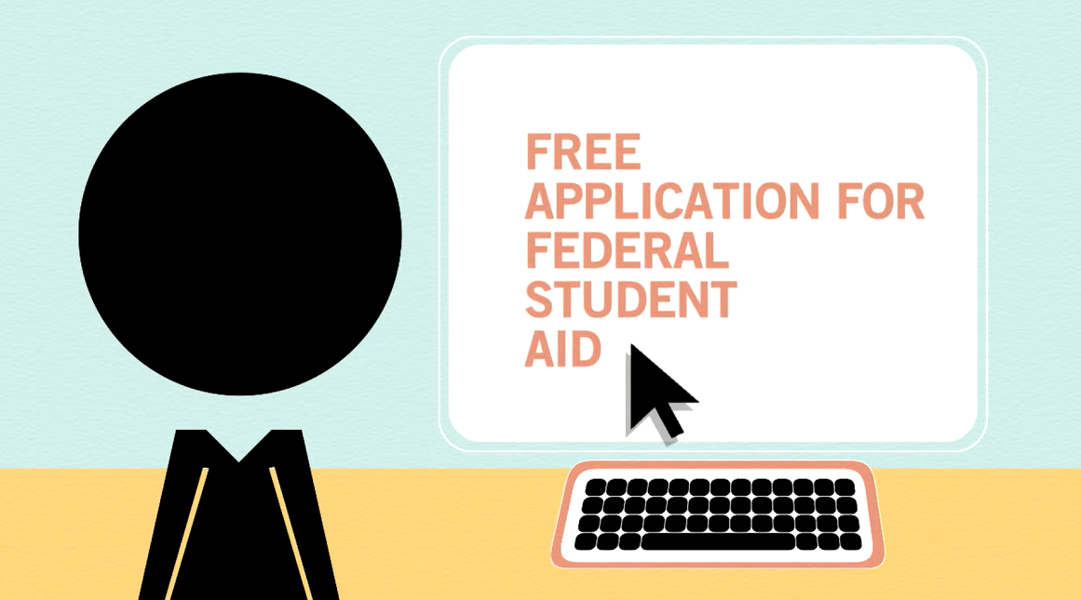
After the FAFSA: What Happens Next
Notes:
https://www.youtube.com/watch?v=gUis5lityCQ
Watch this video produced by Federal Student Aid, an office of the U.S. Department of Education; control-click on the image to launch the YouTube video

Slide 20
Think About It.
Fact: Filing the FAFSA as soon as possible after October 1 might put you near the front of the line for financial aid. To find FAFSA deadlines for your state, visit the Department of Education’s student aid deadlines page.
Brainstorm: Students are allowed to provide up to 10 schools on their FAFSA, but almost 80% of students entering school only provide one. Brainstorm some reasons to list more schools.
Talk About It.
Notes:
Let’s look at each of these

Slide 21
Think About It.
React: Anyone who wants to attend a post-secondary school should apply. Some students may think their GPA isn’t good enough, but most federal student aid programs do not take grades into consideration when you first apply.
Discuss: The FAFSA is a centralized student aid application, what are some benefits of this system?
Talk About It.
Notes:
Let’s look at each of these

Slide 22

3. So You Want a Scholarship
Organize your scholarship application process with these helpful strategies.

Slide 23
Start Early
If you are serious, start as early as 9th grade and begin looking at scholarships awarded to underclassmen. Setting up the process and completing the steps gets easier with repetition.
Most scholarships for high school students are awarded to 12th graders, but completing applications, writing essays and creating a prompt sheet for references will make the process easier each time you do it.

Slide 24
Types of Scholarships
Merit Based – Earned by meeting standards set by the scholarship grantor. May be based on academic achievement, a special talent, or unique interest.
Financial Need – Parent income or your personal income shows the need for assistance.
Affiliation – Available because of your background, a group you belong to, or a special interest.

Slide 25
Free Information Sources to Find Scholarships
High school counselor
Financial aid office at college or career school
Foundations, local businesses, and organizations
Ethnicity-based organizations
Your employer and your parents’ employers
State Granting Agency
Online resources
Notes:
If you are not sure how to begin, ask your school counselor or a teacher. They are there to help.
State agencies often have programs that award loans and grants to students. Find information about your state here:
https://www2.ed.gov/about/contacts/state/index.html
Look for local scholarships where the competition pool is often smaller than for national scholarships.

Slide 26
Information to Gather for Scholarship Applications
School
Transcripts
Letters of recommendation
Academic information
Personal
Personal Information
Personal statement or essay
Other
School & community activities
Employment
Awards & honors

Slide 27
School
Transcripts should be official. Ask your school for an official transcript for each scholarship application.
Seek strong letters of recommendation from people who know you well and can speak to your strengths in a personal way.
Prepare a prompt sheet or a resume for the people you ask to write recommendations for you. Make sure they know what to emphasize for each scholarship application.
Notes:
On your prompt sheet you should list your accomplishments, GPA, academic recognitions, awards, employment, and family responsibilities. Include the field you hope to pursue if you know, and any community service or volunteer work you have done.

Slide 28
Personal
In your cover letter include personal information such as contact information and an email address.
School and community activities are important to include. They explain more about who you are and how you see your place in your school and community.
Explain your employment experience if you have held a job. Being employed and going to school demonstrates time management skills.
Awards and honors you have received may go on the application or in the cover letter.

Slide 29
Essay
Your statement or essay may be the most important part of a scholarship application. This is your opportunity to convince the scholarship committee to choose you. Be creative and tell your story by sharing your background and personal experiences.
Outline your thoughts, write, edit, and rewrite.
Ask a trusted adult to proof and make suggestions.
Be sure there are no spelling or grammar errors.
Notes:
It is hard to stand out academically when you apply for a scholarship, that is the reason your essay is so important. A compelling and interesting story is more important than a perfect GPA.

Slide 30
A few last tips
If you really want scholarship dollars, view your scholarship applications as serious and important business.
Apply for every scholarship for which you are eligible.
Do not miss deadlines. There will be scholarship deadlines most months of the school year.
Be organized and prioritize your application process each month.
Remember scholarships are free money for school.
Notes:
Career school or college is the next step toward adulthood. Actively apply for scholarships to help pay for school and reduce your debt.

Slide 31
And then…
Check and double check your social media accounts. Remove anything that might leave a poor impression.
Both prospective schools and scholarship grantors may review your online presence.

Slide 32
Think About It.
Fact: According to Sallie Mae, half of all scholarships are for students already in college. Lesson: Keep applying every year you are in school.
Brainstorm: List the places you can find free information about scholarships.
React: Applying for scholarships isn’t worth the effort.
Discuss: What are the qualities of a great scholarship essay?
Talk About It.
Notes:
Let’s look at each of these

Slide 33

4. Scholarship Scams
A warning…

Slide 34
Scholarship Scams
Warning Signs
They want you to pay for a “service”
Identity Theft
The FAFSA includes a lot of personal information and provides a perfect opportunity for a scammer to steal your identity or your parent’s personal information
They guarantee they will find a scholarship for you
They tell you “Millions of scholarship dollars go unclaimed” or, you can receive “a full ride”
Claim they are from the government
Never give out your FAFSA username and password
Notes:
Source: https://www.consumer.ftc.gov/articles/choosing-college-questions-ask

Slide 35
Don’t fall for it –
“Buy now or miss this opportunity.” Don’t give in to pressure tactics. Remember, the “opportunity” is a chance to pay for information you could find yourself for free.
“We guarantee you’ll get aid.” A company could claim it fulfilled its promise if you were offered student loans or a $200 scholarship. Is that worth a fee of $1,000 or more?
“I’ve got aid for you; give me your credit card or bank account number.” Never give out a credit card or bank account number to receive a scholarship. You could be putting yourself at risk for both theft and identity theft.
Remember the government is NOT going to call you and you should never pay to talk to someone in the government
Notes:
You might have heard or seen these claims at seminars, over the phone from telemarketers, or online.
Ask yourself, is the service worth the money?
What are they really offering?
And finally, if it is too good to be true, it probably isn’t true!

Slide 36

5. Financial Aid
Understand the different types of financial aid.

Slide 37
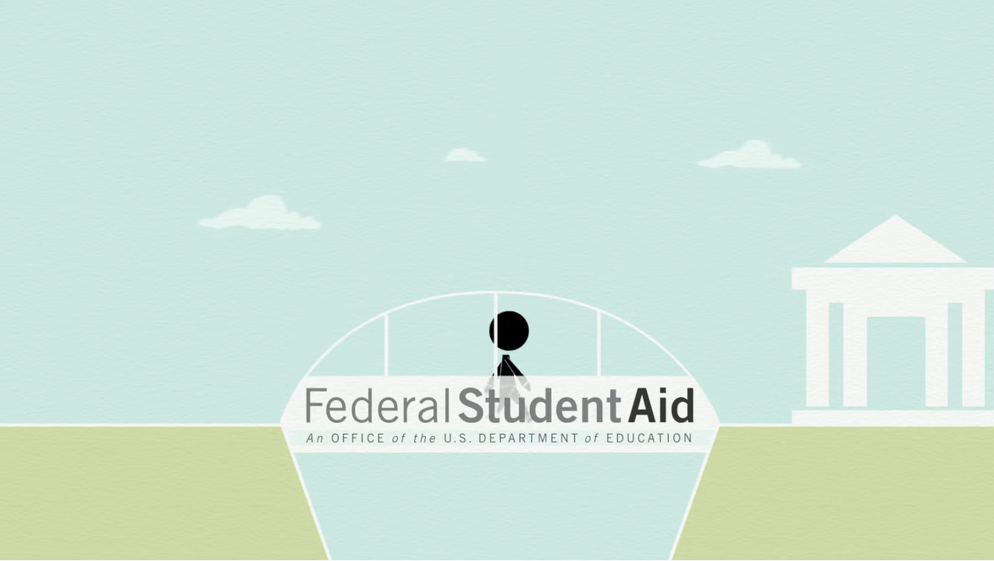
Types of Federal Student Aid
Notes:
https://www.youtube.com/watch?v=Pn4OECMTh5w
Watch this video produced by Federal Student Aid, an office of the U.S. Department of Education; control-click on the image to launch the YouTube video

Slide 38
Loans
Federal Direct Subsidized Loan
Undergraduate students with financial need qualify
Federal Direct Unsubsidized Loan
Undergraduate students with financial need qualify
Interest charged while in school
Direct PLUS Loan
Loan to a parent to pay for a dependent child’s education
Must have a good credit history
Private Loan
Usually no interest charged while in school
Department of Education is the lender
Department of Education is the lender
Department of Education is the lender
Must have a good credit history or a co-signer with one
Interest charged while in school
Funded by banks, credit unions, and online lenders
Notes:
While Federal Direct Subsidized Loans are based on financial need, Unsubsidized loans are not.
If you are an undergraduate student the maximum amount you can borrow each year in Direct Subsidized Loans and Direct Unsubsidized Loans ranges from $5,500 to $12,500 per year.

Slide 39
Federal Direct Subsidized Loan
Your school determines the amount you can borrow.
A first-year student is limited to borrowing $3,500. That limit increases to $7,500 for the third year and beyond.
The U.S. Department of Education pays the interest on this loan while you are enrolled in school and during the first six months after you leave school, (this is called a grace period).
Requires no credit history and no co-signer.

Slide 40
Federal Direct Unsubsidized Loan
There is no requirement to show financial need.
Your school determines how much you can borrow.
You are responsible for paying the interest once you receive the loan.
If you do not pay the interest while you are in school, it will accumulate and be added to the amount of your loan.

Slide 41
Direct PLUS Loan
For parents who are borrowing money to pay for their dependent undergraduate child’s education.
Financial need is not required.
Must have a positive credit history.
COA (Cost of Attendance) minus other financial assistance is the maximum amount you can borrow.
Notes:
Student PLUS Loans are also available for students enrolled in graduate or professional school.

Slide 42
Private Student Loans
Always borrow using federal student loans before private loans.
Private student loans originate with a bank, credit union, or online lender rather than the federal government.
Private student loans can be a good option if:
You have already borrowed the maximum in both subsidized and unsubsidized federal student loans.
You have good credit or a co-signer who does. Most private student loans require a co-signer.
You compare offers from multiple private lenders to find the lowest interest rate.
Notes:
The interest on private loans is calculated and paid from the date you receive the funds.
Source: https://www.nerdwallet.com/best/loans/student-loans/private-student-loans

Slide 43
Grants
Pell Grant
FSEOG
Administered directly by the financial aid office at each participating school
FSEOG is in addition to a Pell Grant
Administered by the federal government
Provides funds to every eligible student, determined by their FAFSA application
Does not need to be repaid
Does not need to be repaid
Notes:
FSEOG stands for Federal Supplemental Educational Opportunity Grant. The purpose of this grant, which is funded by the federal government but awarded by the school, is to provide additional funds for students who might not otherwise be able to attend school. Since these funds are limited this is another reason to apply to all schools early.

Slide 44
How much to borrow?
Factors to consider:
Where you attend school and the cost of living in that area
The COA or Cost of Attendance
The amount of financial aid offered from the school including scholarships, work-study, and grants

Slide 45

Responsible Borrowing
Notes:
https://www.youtube.com/watch?v=mTHtn0FRMWw
Watch this video produced by Federal Student Aid, an office of the U.S. Department of Education; control-click on the image to launch the YouTube video

Slide 46
Work-Study
Provides part-time employment while enrolled in school.
Is available to full-time or part-time students attending schools participating in the Federal Work-Study Program.
Has limited funds. If you are interested in getting a Federal Work-Study job, make sure you apply early.
Notes:
Once you receive work-study, contact your school financial aid office for job placement.

Slide 47
State-Based Financial Aid
Almost every state education agency has at least one grant or scholarship available to residents.
Many states and colleges have earlier deadlines for applying for state and institutional financial aid.
State aid may require an application in addition to the FAFSA.

Slide 48
Serving Our Country
Joining the military or AmeriCorps is another way to pay for post-secondary education. If you serve our country there is aid that will cover some or all of your educational costs.
AmeriCorps This nonmilitary community-service program provides help with college costs and student loans to members who successfully complete service.
U.S. Service Academies The U.S. Air Force, U.S. Army, U.S. Coast Guard, U.S. Merchant Marine, and U.S. Navy provide free education for students who commit to serve in the military for at least four years upon completion of their education.
Reserve Officer Training Corps (ROTC) This campus-based program offers scholarships to students who serve in the military after college.
GI Bill Once you have served in the armed forces, you may receive financial support for college.

Slide 49
Think About It.
Fact: Federal loans are almost always the best deal, but there are many private lenders. Before accepting any loans compare interest rates and fees, and estimate your total amount of debt upon graduation.
Brainstorm: List and compare all of the expenses you might have attending school away from home versus living at home while going to school.
Talk About It.
Notes:
Let’s look at each of these

Slide 50
Think About It.
React: Colleges expect about 50 percent of a student's income and 20-25 percent of a student's assets to be spent on college. They expect parents to contribute much smaller percentages of their income and assets.
Discuss: Why is it important to have a family discussion to determine how much student loan debt is acceptable when you graduate?
Talk About It.
Notes:
Let’s look at each of these

Slide 51

6. Debt Repayment
Before you borrow think about the repayment plan.

Slide 52
Repayment
Be thoughtful about repaying your student loan debt.
Research the starting salaries of graduates in your field.
Realize that typical repayment plans require you to use between 10-20% of your discretionary income to repay loans after you leave school.
Consider the impact student loan repayment and student loan interest will have on your budget and lifestyle after school.
Review your loan repayment plans and ask questions.
Notes:
You must repay your loan, so be sure you understand your options and responsibilities.

Slide 53
Student Loan Servicer
A loan servicer is a company assigned to handle the billing and other services on a federal student loan, at no cost to you.
The loan servicer will work with you on repayment options and assist with other tasks related to federal student loans.
A loan servicer is assigned after the loan is paid out. This is the entity you will deal with going forward.
Notes:
Never pay an outside company for help with your federal student loans. Your loan servicer will help you for FREE.

Slide 54
PSLF – Public Service Loan Forgiveness Program
If you work for an approved agency or organization and you have federal Direct Loans your debt could be erased.
Students should explore this option and register, if their first job is with a qualifying employer.
While debt forgiveness comes after ten years of payments and qualifying employment, it is a program worth knowing about.
Notes:
While ten years seems like a long time, many borrowers find it takes longer than ten years to pay off their education loans.
Because you must make 120 qualifying monthly payments, it will take at least 10 years before you can qualify for PSLF.

Slide 55
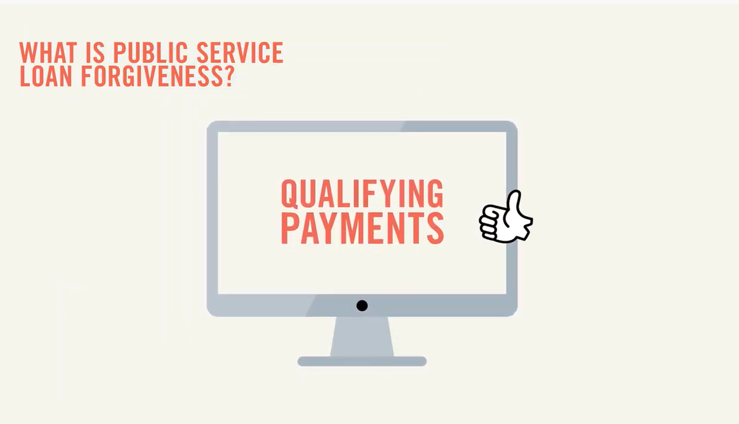
PSLF – Public Service Loan Forgiveness
Notes:
https://www.youtube.com/watch?v=HKbP4pV8ph0
Watch this video produced by Federal Student Aid, an office of the U.S. Department of Education; control-click on the image to launch the YouTube video

Slide 56
Know what you can afford to repay
1 in 8 Americans has student loan debt
Typical student loan debt:
certificate completion $17,000
associate’s degree $22,000
bachelor’s degree $33,000
When you borrow, use a student loan calculator to estimate your future loan payments. Keep that figure in mind as you plan for your future.

Slide 57
Consequences of student loan debt
Student loan debt often affects:
buying a home
saving for retirement or long-term goals
daily standard of living
discretionary income
Notes:
As you know borrowing money means paying back money with interest. Student affects your spending power for years. You should carefully choose you debt limit and keep in mind that each and every time you borrow.

Slide 58
Delinquency and Default
The first day after you miss a student loan payment, your loan becomes past due, or delinquent.
If your loan continues to be delinquent, the loan may go into default.
Going into default has serious consequences for your financial future and can affect everything from getting a job to the interest rates you pay for other credit, such as a credit card or mortgage loan.
Notes:
According to the Consumer Financial Protection Bureau, Borrowers who default are overwhelmingly non-completers … These borrowers take on some debt but do not benefit from the wage increase associated with a degree.”

Slide 59
Think About It.
Fact: You can borrow less than your school offers and borrow additional funds later if you need to. You should borrow only what you need.
Brainstorm: What are the pros and cons of working part time or full time while attending school?
React: Justify your choice: Taking on more debt to attend a “dream” private school, versus assuming less debt to attend a public school.
Talk About It.
Notes:
Let’s look at each of these

Slide 60
Think About It.
Discuss: A 2021 high school graduate who depends on student loans to help pay for college could expect to borrow $38,147 for their bachelor’s degree, plus interest. How does this affect their adult life?
Talk About It.
Notes:
Let’s look at each of these

Slide 61

The Future is Yours to Manage
Make Yourself Proud!

Slide 62
Thank you
LifeSmarts thanks Toyota North America for an educational grant to develop this lesson

